Slide 1

Mobile and Simulation-based Approach to Reduce Dyslexia in Children with Learning Disabilities
24-25J-133

Slide 2


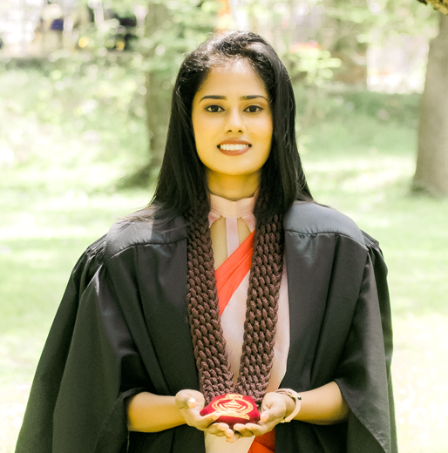
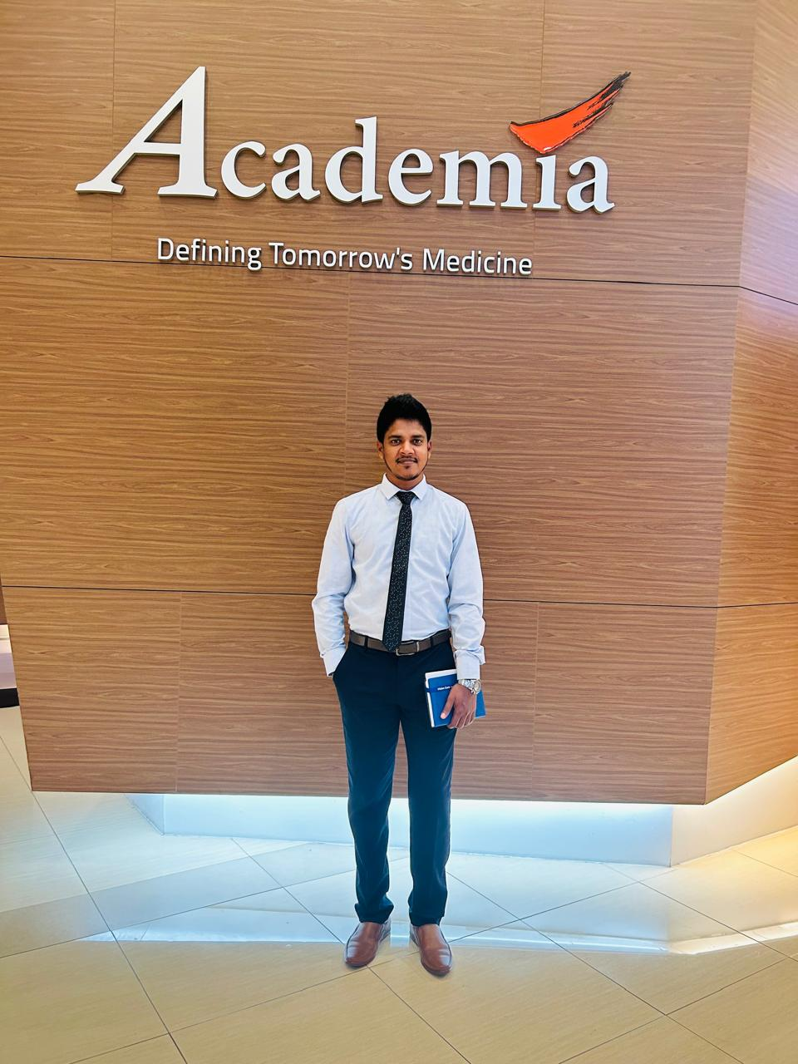

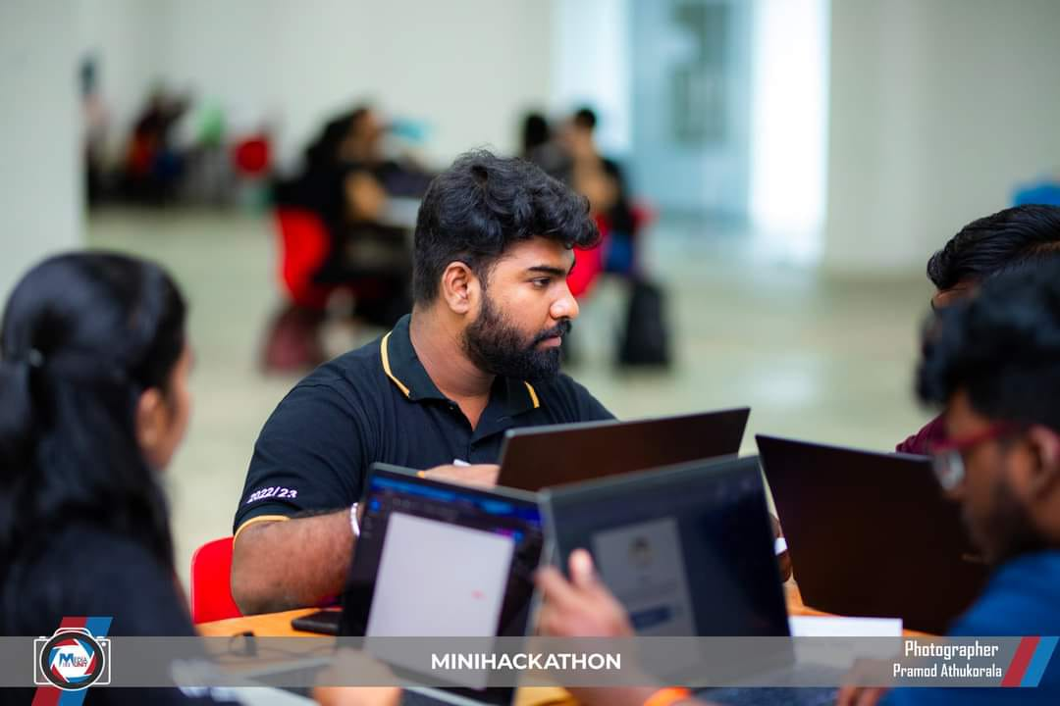
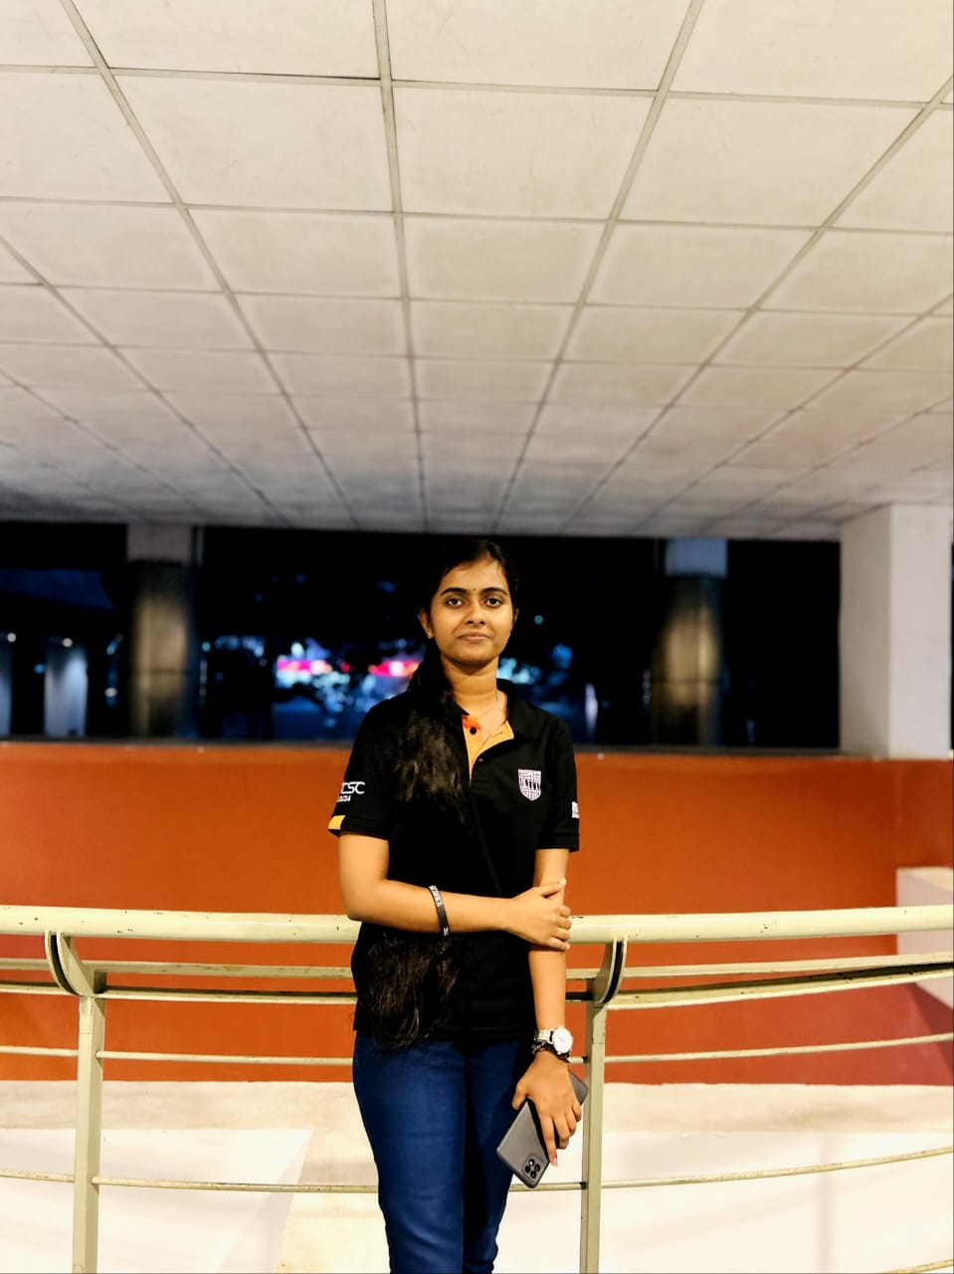
Members
Supervisor Dr. Kapila Dissanayaka
Co –supervisor Ms. Rivoni De Zoysa
External supervisor Dr. P. Gowritharan Speech and language Therapist & Counsellor Teaching Hospital- JAFFNA SLMC Reg : 113
Group Leader Shangeeth.V
Sanjeeva.N
Thiraviyarasa.A

Slide 3

Introduction to the overall project
1. What is dyslexia, and how does it affect children?
2. Why is there a need for a mobile application to support children with dyslexia?

Slide 4

Research Questions
How can a mobile application utilizing innovative solutions, such as Natural Language Processing (NLP) and machine learning, support children with dyslexia in improving their reading, processing, and memory skills?

Slide 5

Research Objectives
Main Objective To design and develop a mobile application that utilizes innovative solutions to support children with dyslexia in improving their reading, processing, and memory skills.

Slide 6
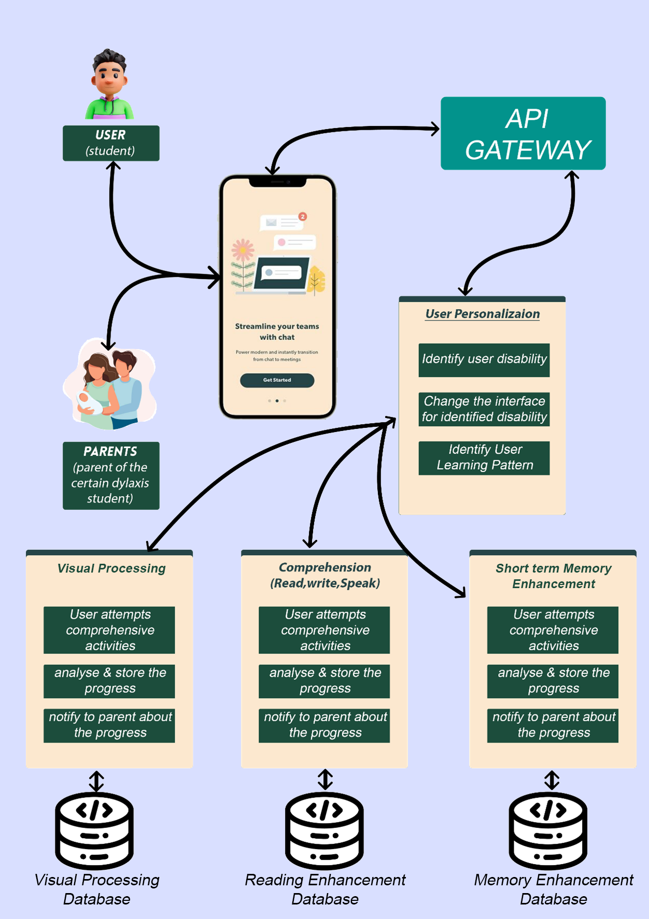
Overall solution as a system diagram

Slide 7
GitHub Details
https://github.com/IT21273858/24-25J-133.git

Slide 8

It21273858 |Shangeeth.V
SOFTWARE ENGINEERING
IT21273858 | Shangeeth.V | 24-25J-133

Slide 9

Component 01
Visual Processing Module
IT21273858 | Shangeeth.V | 24-25J-133

Slide 10
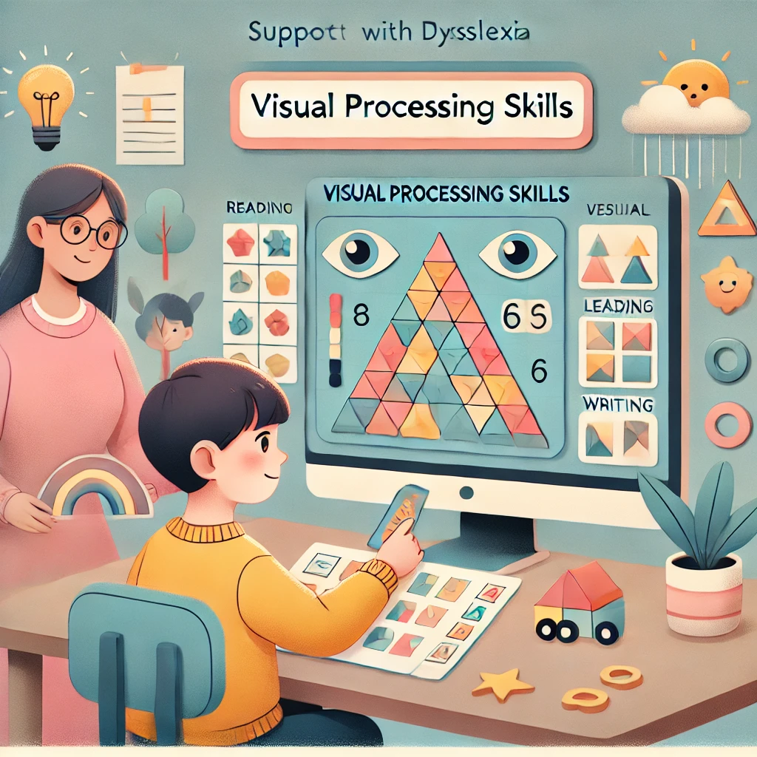
Introduction
Background
Research probelem
Objectives
IT21273858 | Shangeeth.V | 24-25J-133

Slide 11

Background
This Module is designed to support children with dyslexia who often struggle with visual perception and discrimination.
Research suggests that individuals with dyslexia may have underlying visual processing issues that impact their ability to learn.
Visual discrimination difficulties can impact students' performance in reading, writing, and mathematics.
By addressing these core visual processing challenges, the Visual Processing Improvement Module aims to enhance overall learning outcomes for children with dyslexia.
IT21273858 | Shangeeth.V | 24-25J-133

Slide 12
Research Problem
How can machine learning, Image processing algorithms be leveraged to dynamically adjust visual processing activities and games, improving visual skills of children with dyslexia?
IT21273858 | Shangeeth.V | 24-25J-133

Slide 13
Specific and Sub Objectives
Main Objective:
To design and develop a Visual Processing Module that improves the visualizing abilities of students with visual processing difficulties, including those with dyslexia.
Sub-Objectives:
Improve Visual Comprehension.
Enhance the capacity to distinguish between subtle differences in visual stimuli.
Enhance the ability to perceive complete pattern from incomplete pattern.
IT21273858 | Shangeeth.V | 24-25J-133

Slide 14
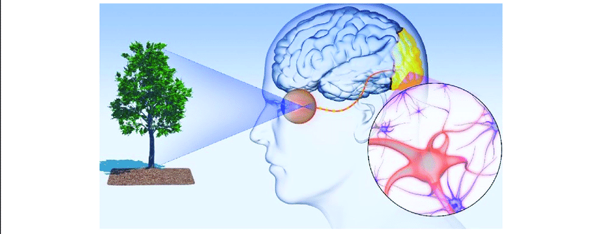
Methodology
System Diagram
Tool & Technologies
Github Commits
IT21273858 | Shangeeth.V | 24-25J-133

Slide 15
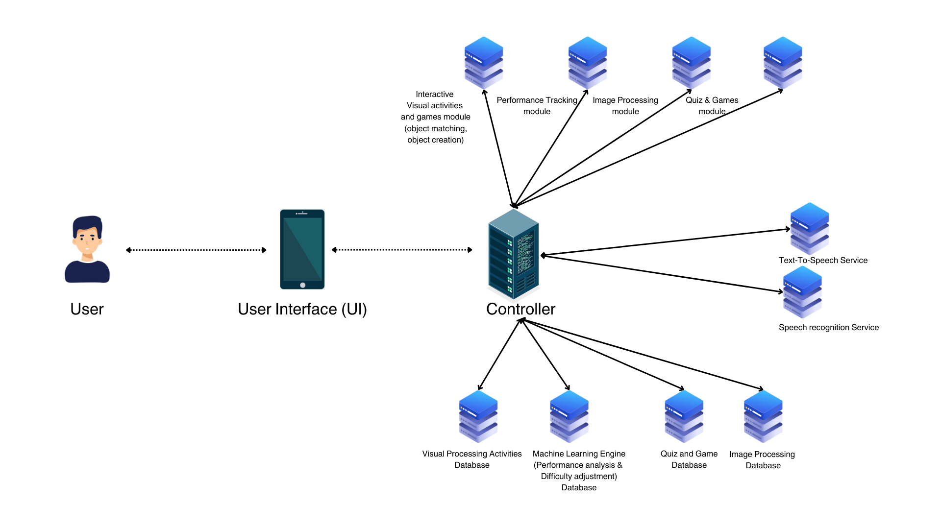
System Diagram
IT21273858 | Shangeeth.V | 24-25J-133

Slide 16





Tools & Technologies
Technologies
Machine learning
TensorFlow and Keras for training models.
CNN for image-based shape recognition.
LSTM for sequential pattern prediction.
GAN for generating colorful shapes.
Languages
Python, Flutter, Node
Storage
MongoDB (Prisma)
IT21273858 | Shangeeth.V | 24-25J-133

Slide 17
Requirements
Functional
Visual Identification Activities
Non-Functional
Reliability
Visual Differentiation of objects
Dynamic Difficulty Adjustment
Accessibility
Engagement
IT21273858 | Shangeeth.V | 24-25J-133

Slide 18
Key Features
1. Model Training for Shape Recognition and Pattern Prediction
Trained a Convolutional Neural Network (CNN) for shape recognition.
Used an LSTM model for sequence-based pattern prediction.
Algorithms such as Adam Optimizer and categorical cross-entropy loss were employed to optimize model training.

Slide 19
Overfitting Mitigation
1. Model Training for Shape Recognition and Pattern Prediction
Added dropout layers to prevent co-adaptation of neurons.
Used data augmentation techniques (e.g., rotation, scaling, flipping) to expand the training dataset.
Monitored the training using early stopping to avoid unnecessary epochs.
Adopted batch normalization to improve generalization.

Slide 20
Key Features
2. Game Allocation Based on Child Profile
Used MongoDB as the primary database with Prisma ORM for schema management and querying.
Child profiles were stored with attributes like level, scores, and completed games.
Implemented logic to assign games based on the child’s current level:
If a child wins, their level increases.
If a child loses, their level decreases (ensuring it doesn’t go below zero).

Slide 21
Key Features
3. Dynamic Scoring System
Scores are computed based on:
Game completion time relative to expected playtime.
Algorithms were used to calculate penalties for exceeding playtime and rewards for faster completion.
Stored game scores in the database for historical tracking and analysis.

Slide 22
Key Features
4. Game Generation
A GAN (Generative Adversarial Network) model was trained to generate colorful shapes (like circles, squares, and triangles).
Used data augmentation and WGAN-GP (Wasserstein GAN with Gradient Penalty) to stabilize GAN training and avoid mode collapse.

Slide 23
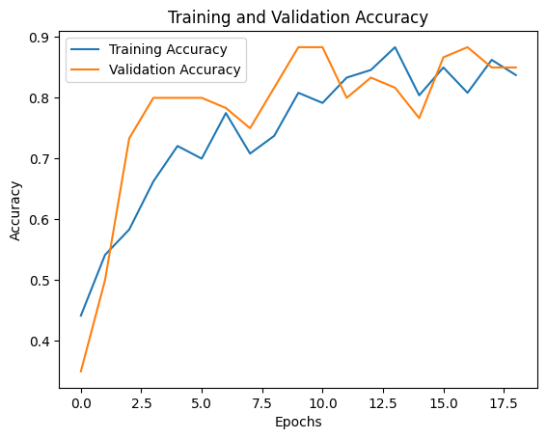
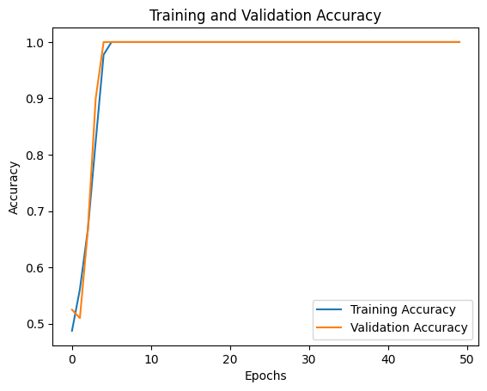
Key Features
5. Testing and Accuracy
Achieved accuracy:
Shape recognition model: ~95%
Pattern prediction model: ~92%
Performed k-fold cross-validation to ensure model robustness.
Shape Generation
Pattern Prediction

Slide 24
Challenges and Solutions
Overfitting
Challenge: Models were overfitting due to limited training data.
Solution:
Introduced data augmentation to increase dataset variability.
Added dropout and batch normalization to regularize the model.
Used early stopping to halt training once validation loss plateaued.

Slide 25
Challenges and Solutions
GAN Training
Challenge: GANs are notoriously unstable during training.
Solution:
Adopted WGAN-GP to improve stability and ensure high-quality image generation.

Slide 26
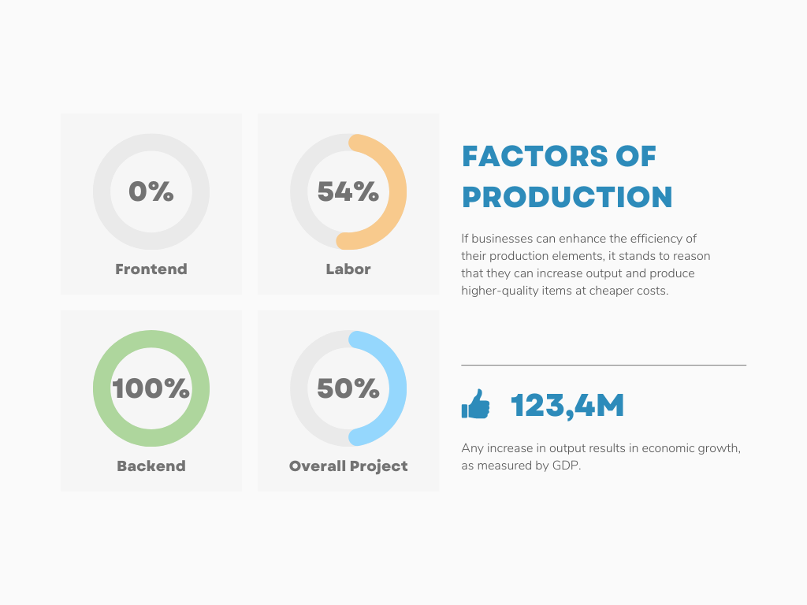
Completion And Remaining Project
Completed
Pending
Train Model.
Evaluate the Model.
Integrate Python to generate Shapes and Patterns.
Real time Level updating of children.
User Management.
Input Validation for requests.
Frontend.
Deployment.
IT21273858 | Shangeeth.V | 24-25J-133

Slide 27
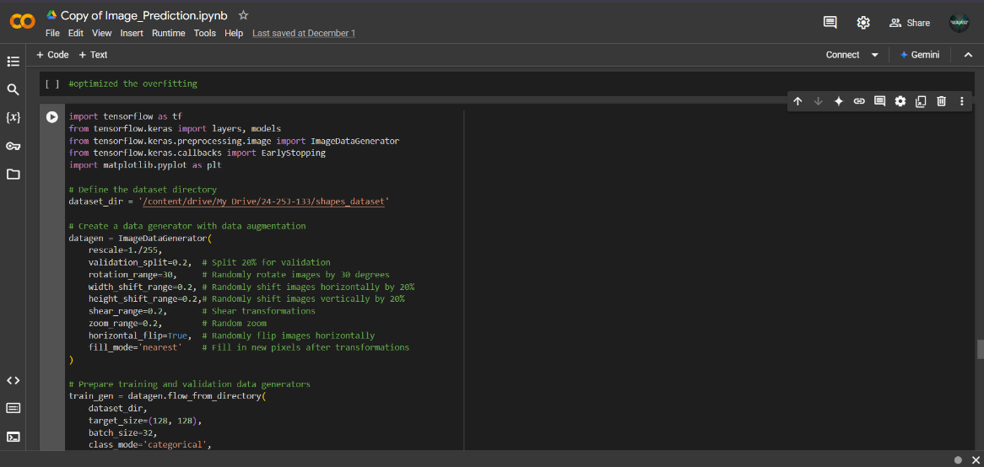
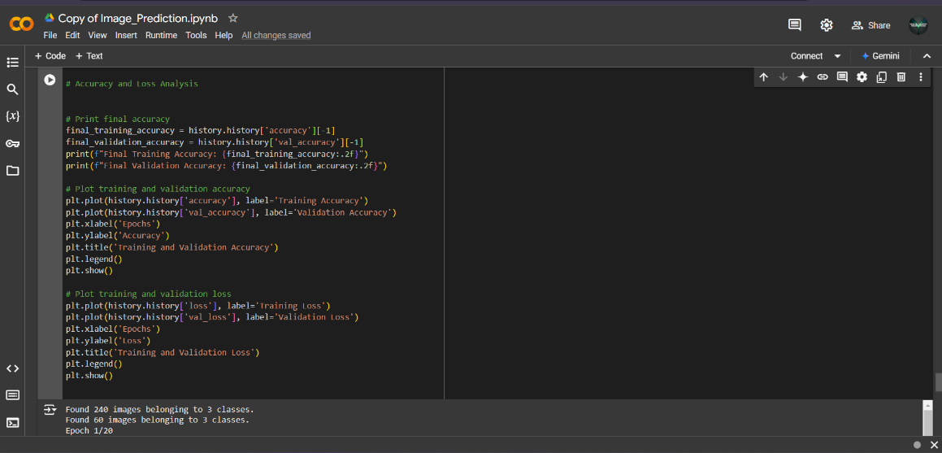
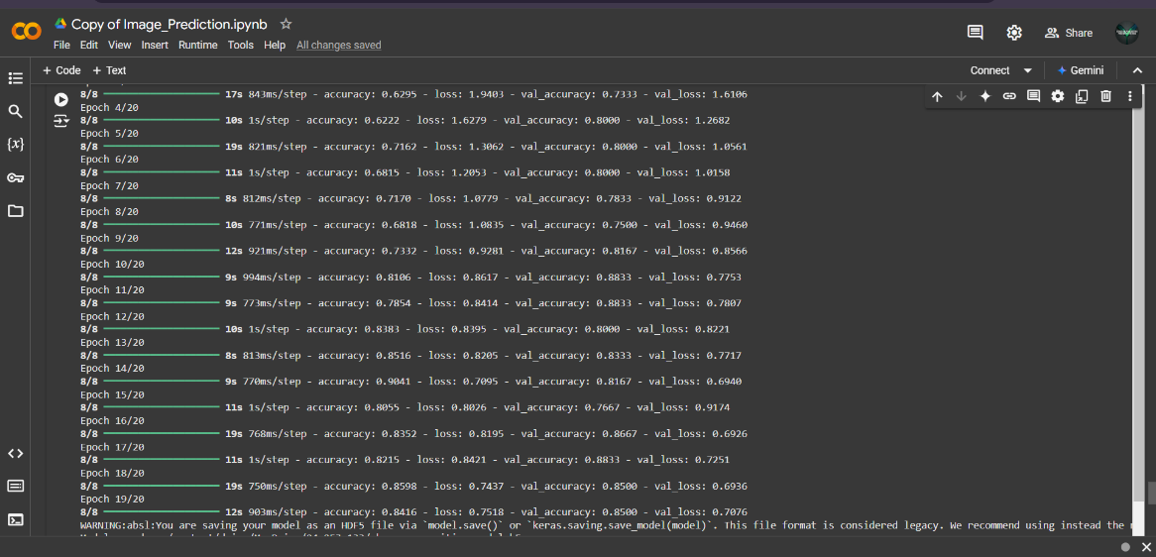
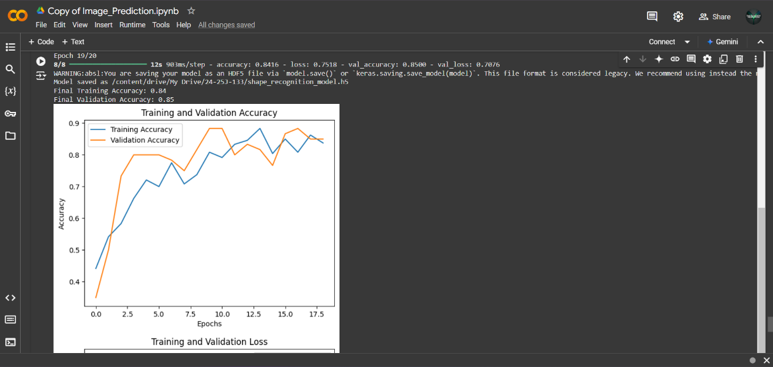
Model Training
Shape Prediction
IT21273858 | Shangeeth.V | 24-25J-133

Slide 28
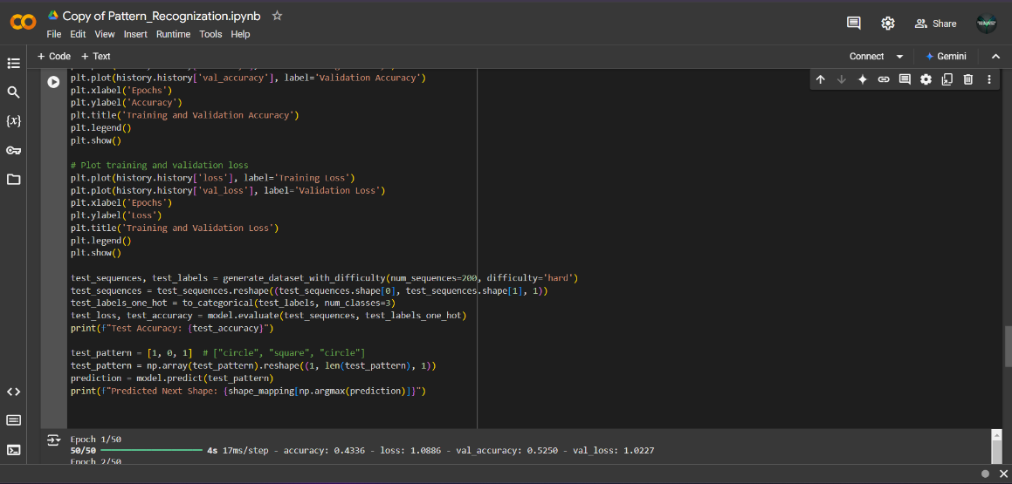
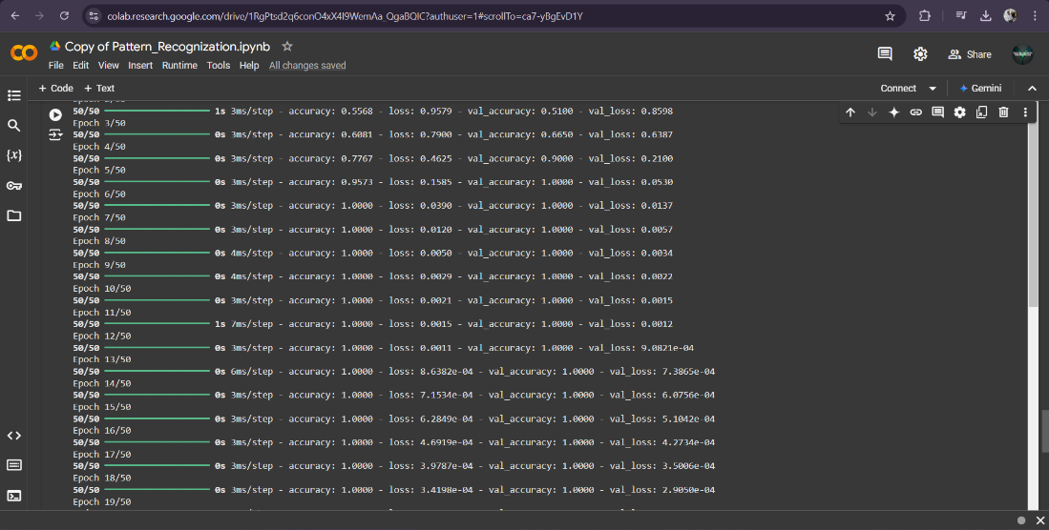
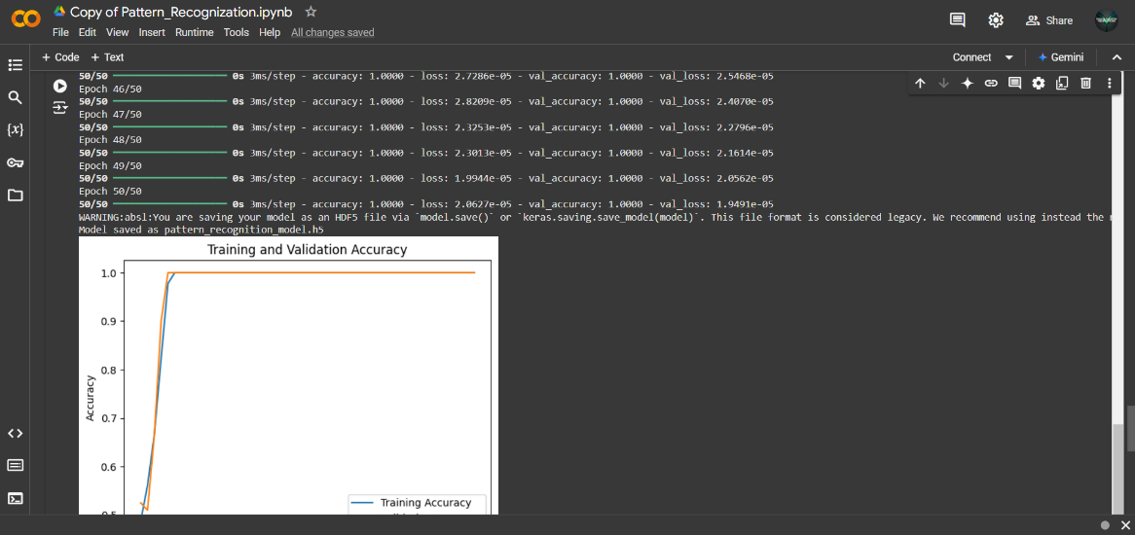
Model Training
Pattern Recognition
IT21273858 | Shangeeth.V | 24-25J-133

Slide 29
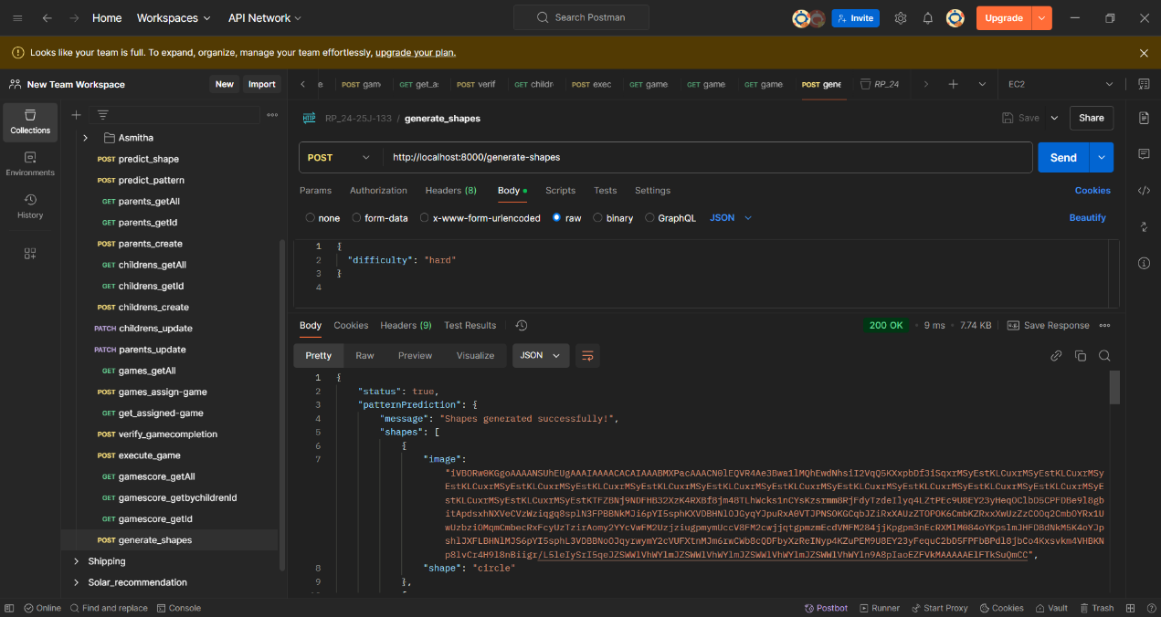
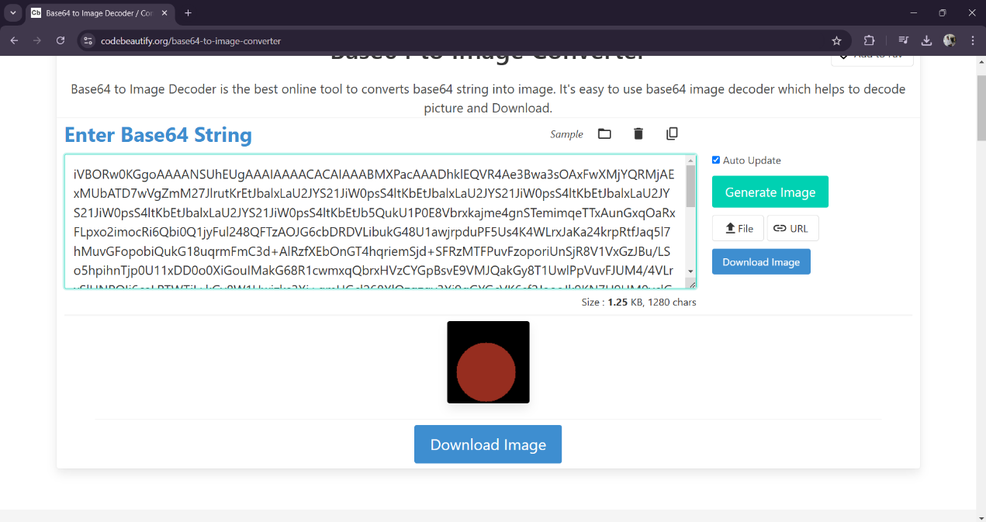
Working Component
Generate Shape
IT21273858 | Shangeeth.V | 24-25J-133

Slide 30
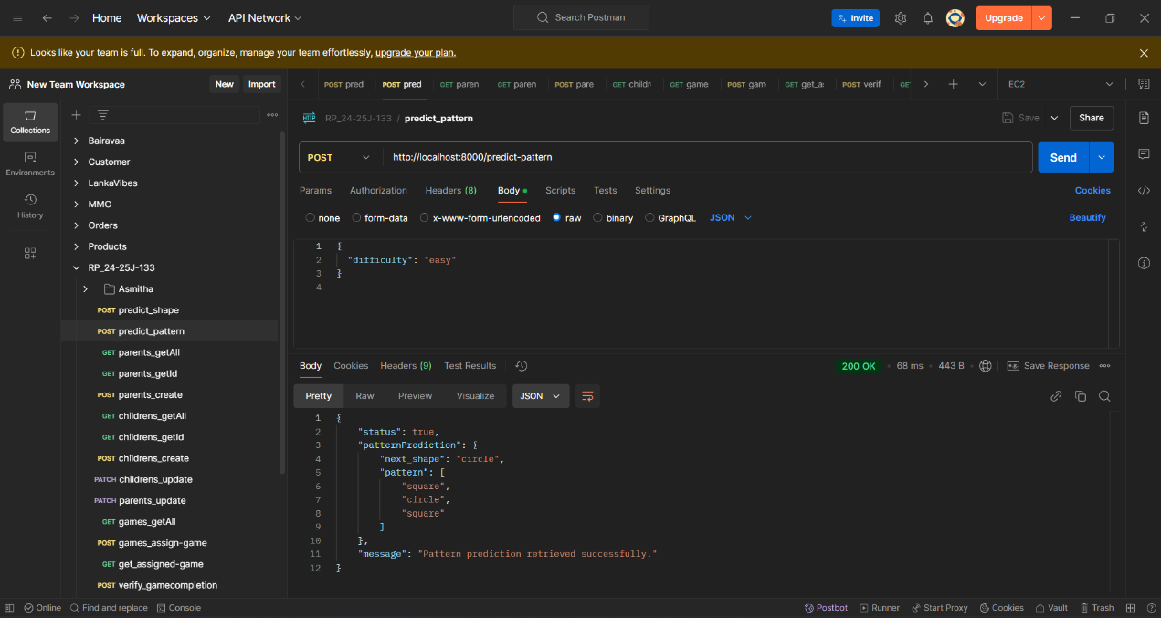
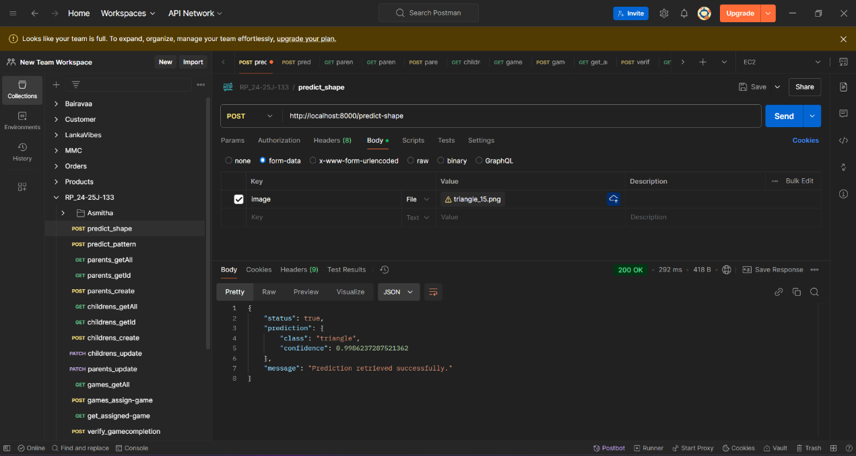
Working Component
Predict Pattern
Predict Shape
IT21273858 | Shangeeth.V | 24-25J-133

Slide 31
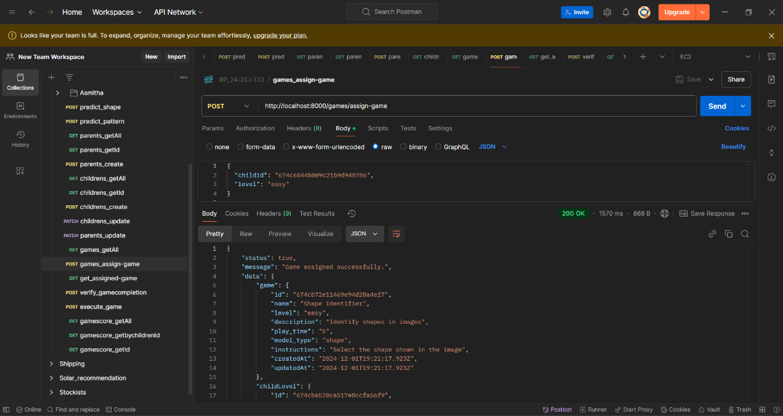
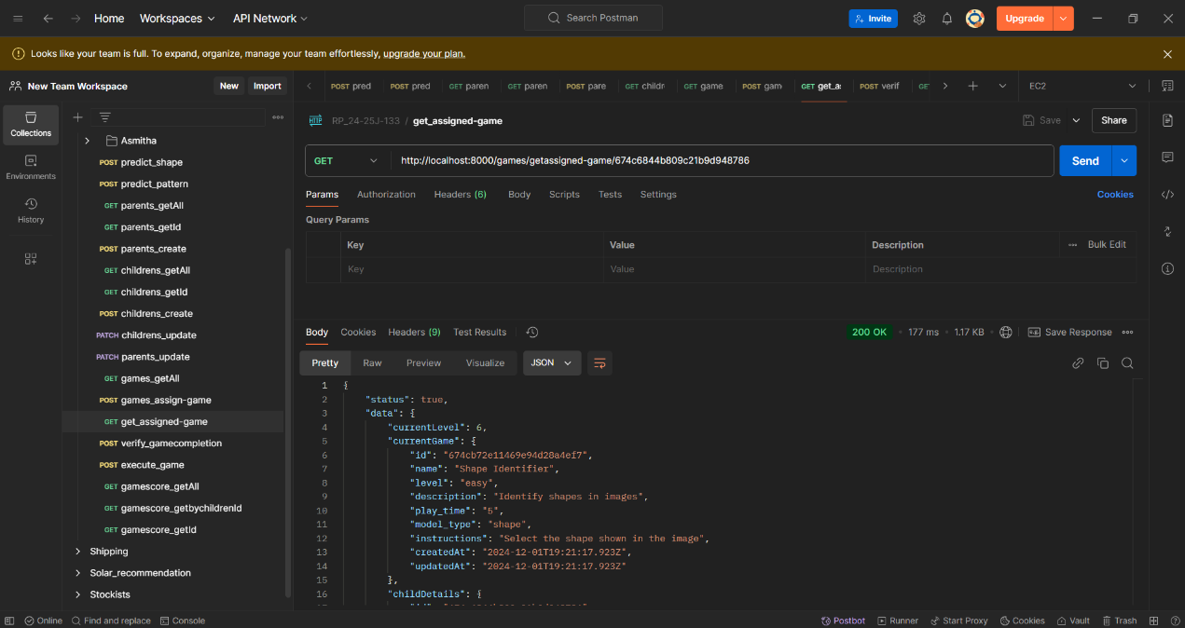
Working Component
Assign Game
Get Assigned Game
IT21273858 | Shangeeth.V | 24-25J-133

Slide 32
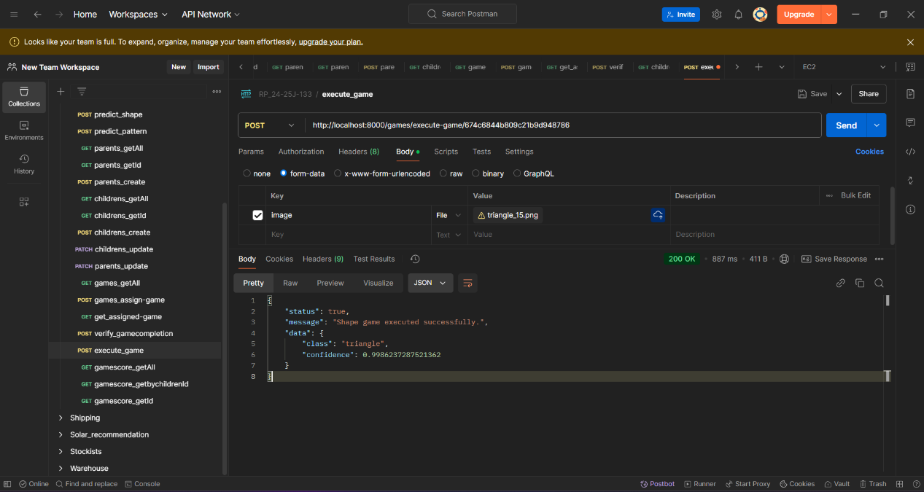
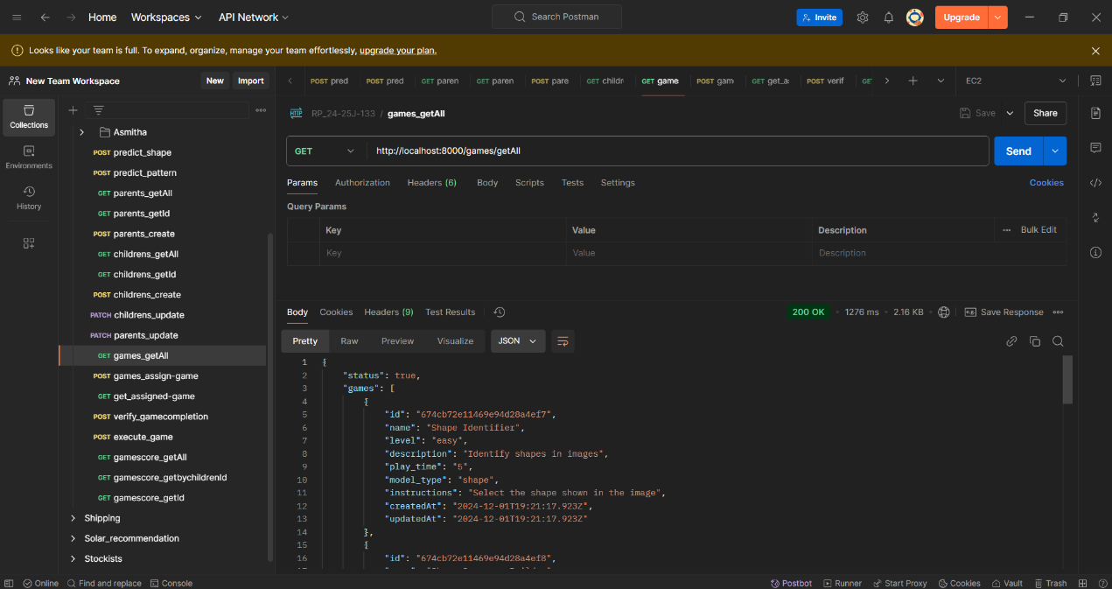
Working Component
Execute a Game
Get All Game
IT21273858 | Shangeeth.V | 24-25J-133

Slide 33
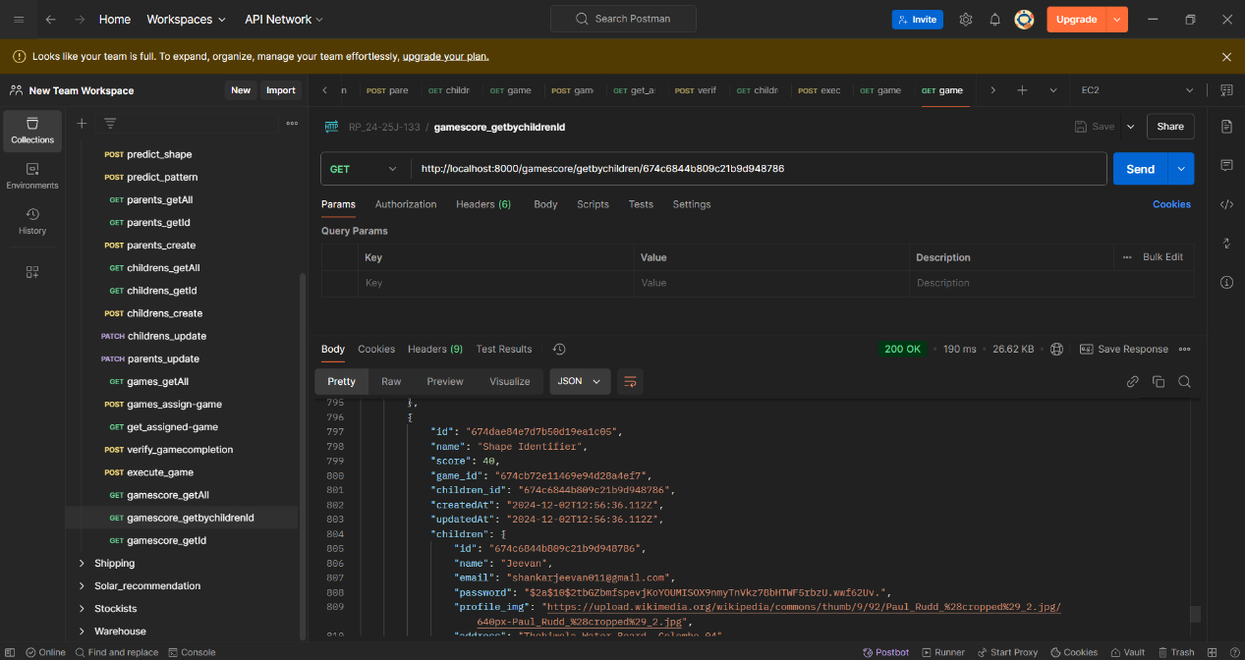
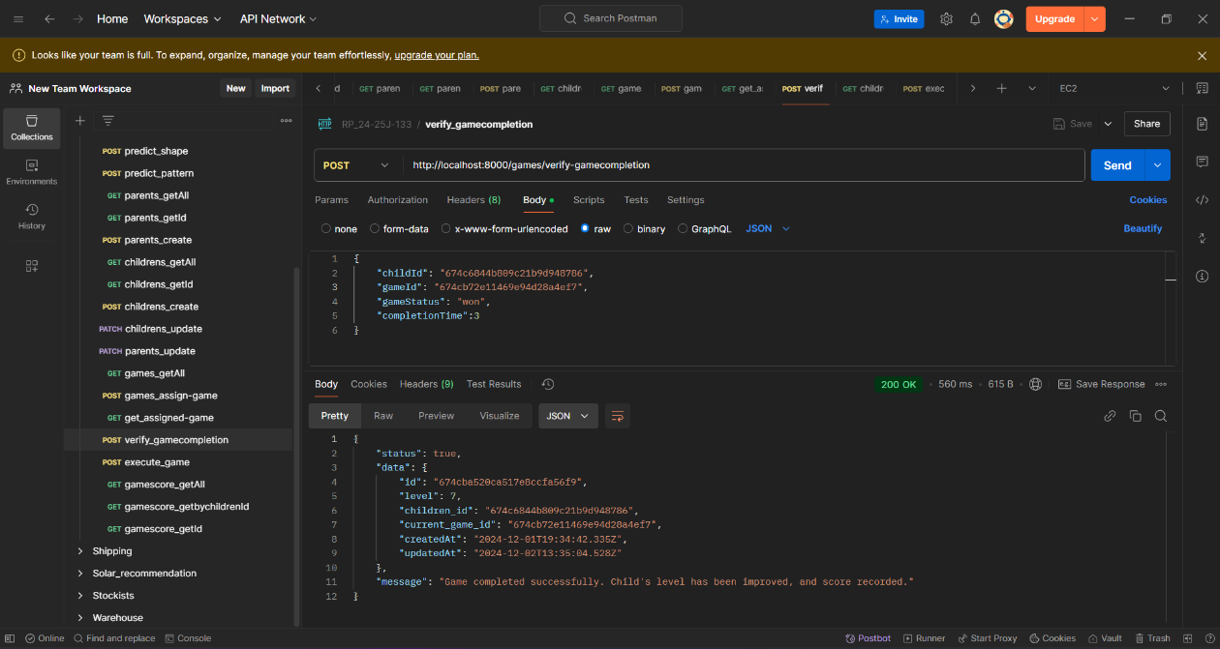
Working Component
Get Game Score for a Children
Decide Win / Loss
IT21273858 | Shangeeth.V | 24-25J-133

Slide 34
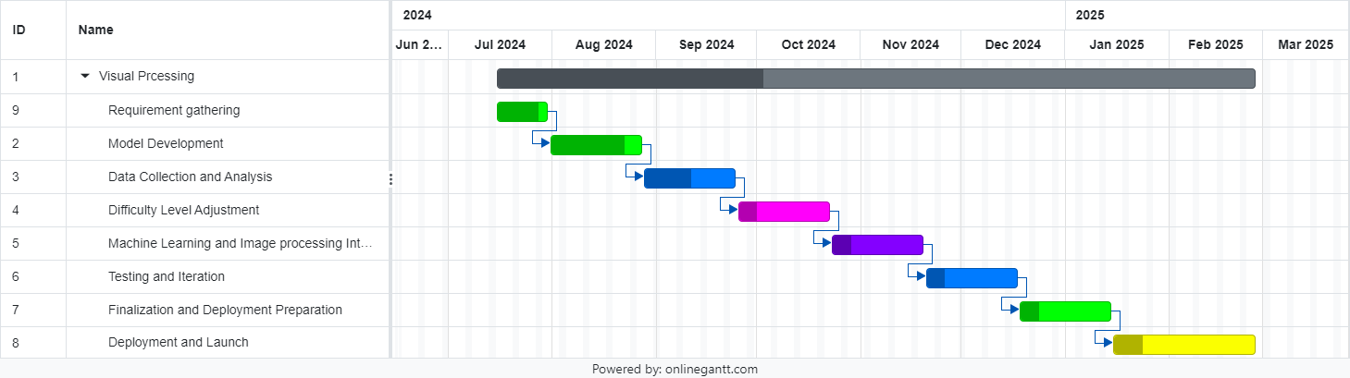
Work Breakdown Structure
Gannt Chart
IT21273858 | Shangeeth.V | 24-25J-133

Slide 35
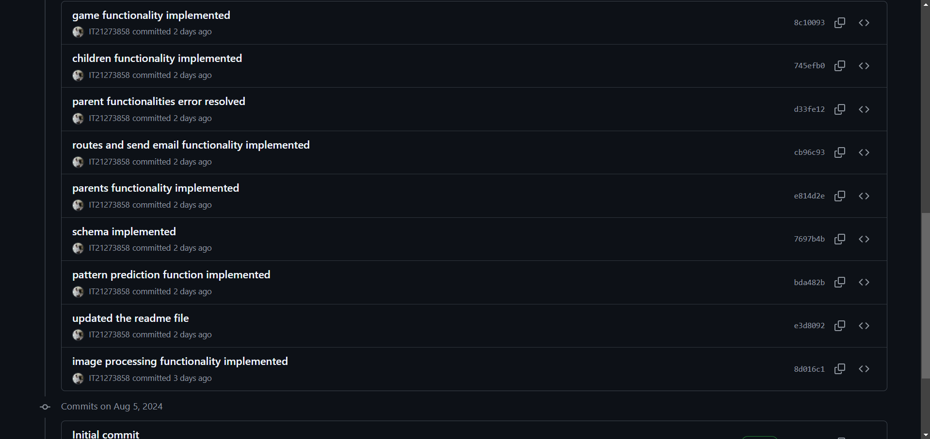
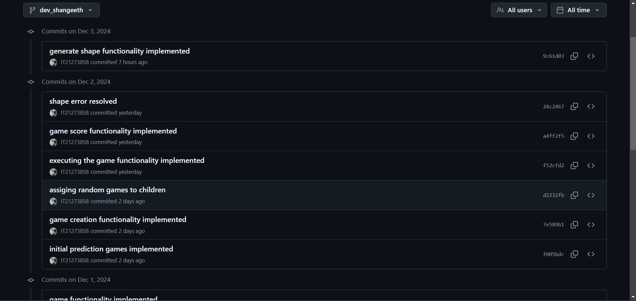
Git Commits
IT21273858 | Shangeeth.V | 24-25J-133

Slide 36
References
[1] Alba Cotarelo and Jose Manuel Redondo, "Applying color recognition techniques to achieve low-cost portable digital board functionalities," Springer Link, vol. 81, p. 8995–9012, 09 02 2022.
[2] J. Parnell, "Friedship Circle," 28 07 2017. [Online]. Available: https://www.friendshipcircle.org/blog/2017/07/28/4-reasons-to-use-apps-for-kids-with-special-needs. [Accessed 12 06 2024].
[3] Kulkatechol Kanokngamwitroj and Chetneti Srisa-An, "Personalized Learning Management System," TEM, vol. 11, no. 4, pp. 1626 -1633, 11 2022.
[4] Himanshu Shekhar, Sujoy Seal, Saket Kedia and Amartya Guha , "Survey on Applications of Machine Learning in the Field of Computer Vision," in Springer, Singapor, 2019.
[5] Piers Cornelissen, Alex Richardson, Alexandra Mason, Sue Fowler and John Stein, "Contrast sensitivity and coherent motion detection measured at photopic luminance levels in dyslexics and controls," Elsevier, vol. 35, no. 10, pp. 1483-1494, 05 1995.
IT21273858 | Shangeeth.V | 24-25J-133

Slide 37
It21334542|Sanjeeva
SOFTWARE ENGINEERING
IT21334542 | Sanjeeva.N | 24-25J-133

Slide 38

Component 02
Reading Skills Enhancement Module
IT21334542 | Sanjeeva.N | 24-25J-133

Slide 39
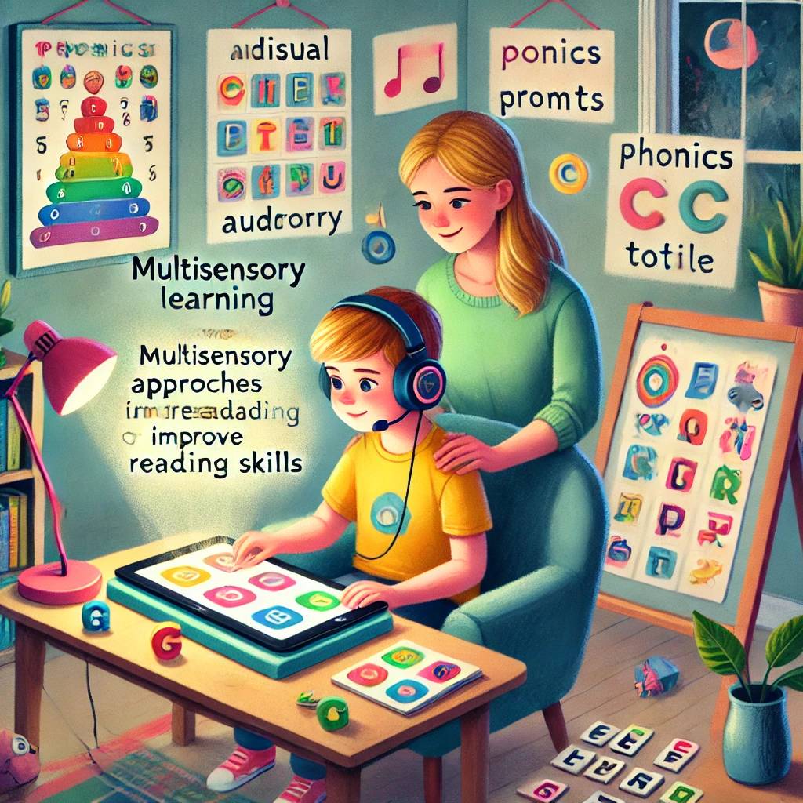
Introduction
Background
Research probelem
Objectives
IT21334542 | Sanjeeva.N | 24-25J-133

Slide 40

Introduction
Background
Dyslexia is a common learning disorder affecting 15-20% of the population, making it challenging for individuals to read, write, and spell.
Children with dyslexia often struggle with phonemic awareness, phonics, fluency, and comprehension, which are essential reading skills.
Traditional teaching methods that focus on rote memorization and repetition can be ineffective for children with dyslexia.
Research-based approaches that incorporate multisensory instruction, technology, and individualized learning have shown promise in improving reading outcomes for children with dyslexia.
IT21334542 | Sanjeeva.N | 24-25J-133

Slide 41

Reading Component
Phenomics awareness
sounds the word made up of
Phonic
Letters / arrangement of the letter, that produces certain sound
Key , Ki can make the same sound.
Fluency
Rate of effort to read a word
IT21334542 | Sanjeeva.N | 24-25J-133

Slide 42
Research Problem
How can interactive learning modules, combined with natural language processing (NLP) techniques, be effectively utilized to enhance the reading skills of children with dyslexia?
IT21334542 | Sanjeeva.N | 24-25J-133

Slide 43

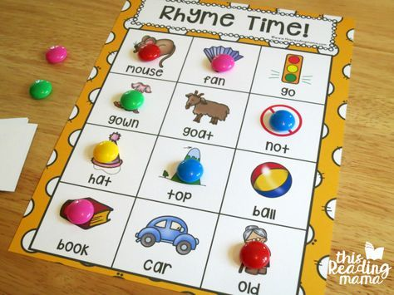

Traditional Enhancement Approaches
Salt Tray
Rhyme Games
Repeated Read

Slide 44
Gaps Identified and Novelties
App existing that serves only targeted scope in Reading Skills
App serves the entire solution and help to reach the ultimate goal of reading - Comprehension
Personalized learning
Usage of ML helps to provide us a personalized user experience.
ML for make prediction in on-boarding identification of user Phonic level &
Identify Learning pattern to recommend adjust the difficulty level for progress.
Missing integration of proven techniques
Incorporating proven techniques like Repeated reading, salt tray in a modern aspect
Early intervention focus

Slide 45
Specific and Sub Objectives
Main Objective:
To design and develop a Reading Skills Enhancement Module that improves the reading abilities of children with dyslexia.
Sub-Objectives:
Phonological Awareness
Decoding and Fluency
Reading Comprehension
Reading Difficulties Reduction
Engagement and Motivation
IT21334542 | Sanjeeva.N | 24-25J-133

Slide 46

Methodology
System Diagram
Tool & Technologies
Github Commits
IT21334542 | Sanjeeva.N | 24-25J-133

Slide 47
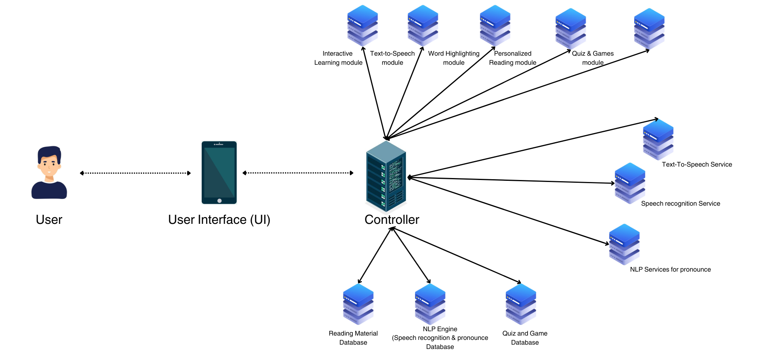
Methodology
System Diagram
IT21334542 | Sanjeeva.N | 24-25J-133

Slide 48
Tools & Technologies
Technologies
Google Speech-to-Text (Evaluate pronunciation)
MFCC-based model (Fluency Accuracy)
Hugging face Stable Diffusion for Generate Image from Text (Pre-tained Model)
Machine Learning
MFCC feature extraction for fluency evaluation
Model training with TensorFlow/PyTorch.
Languages
Python, Flutter, Nodejs
Storage
MongoDB ,Prisma ORM
IT21334542 | Sanjeeva.N | 24-25J-133

Slide 49
Requirements
Functional
Interactive Learning Modules
Non-Functional
Performance
Text-to-Speech and Word Highlighting
Personalized Reading Materials
Scalability
Usability
IT21334542 | Sanjeeva.N | 24-25J-133

Slide 50
Implementation and Functionality
1. Fluency Assessment (WPM) & Pronounce Assesment
Preprocessed Librispeech dataset for model training.
Convertion of transcript from Speech-to-Text for real-time feedback

Slide 51
Implementation and Functionality
2. Comprehension Testing
Image Generation with Stable Diffusion.

Slide 52
Implementation and Functionality
3. Track learning Speed & Create a Profile base Learning Path
Lean modules are categorized as Levels
Onboard Assessment check points to identify child’s core Challenge
Store based on Performance and Increase of levels

Slide 53
Implementation and Functionality
3. Generative Contents
Images for the learn modules, Assessments are Generative by system.
Random , Dynamic Contents for Games like transcripts of audio that processes, words for Games.

Slide 54
Challenges and Solutions
Training Models Locally
Challenge: Training the fluency model on my personal PC was challenging due to repeated "storage full" errors caused by large datasets and limited disk space..
Solution:
Utilized Google Colab for Model Training.

Slide 55
Challenges and Solutions
Noise Disturbance During Recording
Challenge: Background noise during sound recordings significantly affected the accuracy of phonemic awareness testing.
Solution:
Applied noise reduction techniques during audio preprocessing to filter out background disturbances.

Slide 56
Challenges and Solutions
CUDA Compatibility Issue:
Challenge: Encountered an AssertionError: Torch not compiled with CUDA enabled when trying to run the model on the GPU.
Solution:
Reinstalled PyTorch with the correct CUDA-enabled configuration.

Slide 57
Completion And Remaining Project
Completed
Pending
Train Model(Fluency with Librispeech)
Implemented a module to Generate Images for Image Base Assessment
Completed Onboard Assessment to identify the users core challenge
Real time Level updating of children.
Frontend.
Deployment.
IT21334542 | Sanjeeva.N | 24-25J-133

Slide 58
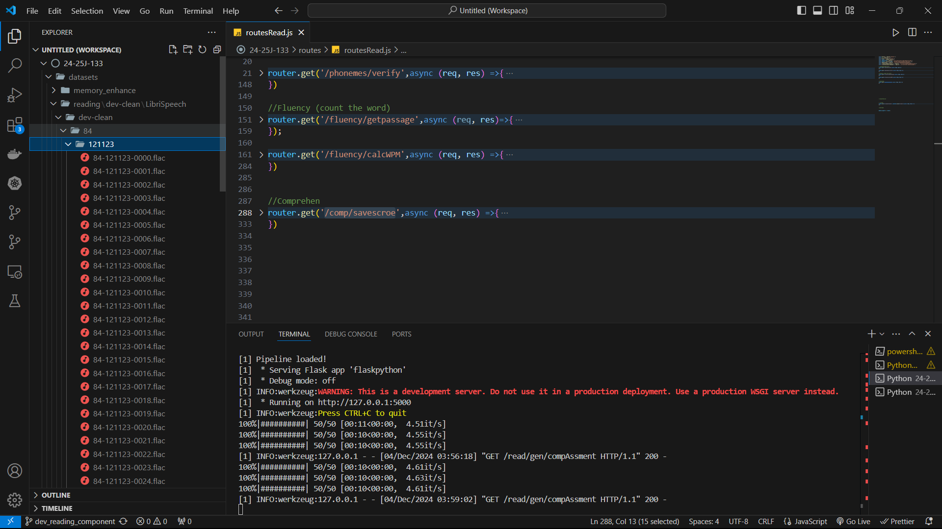
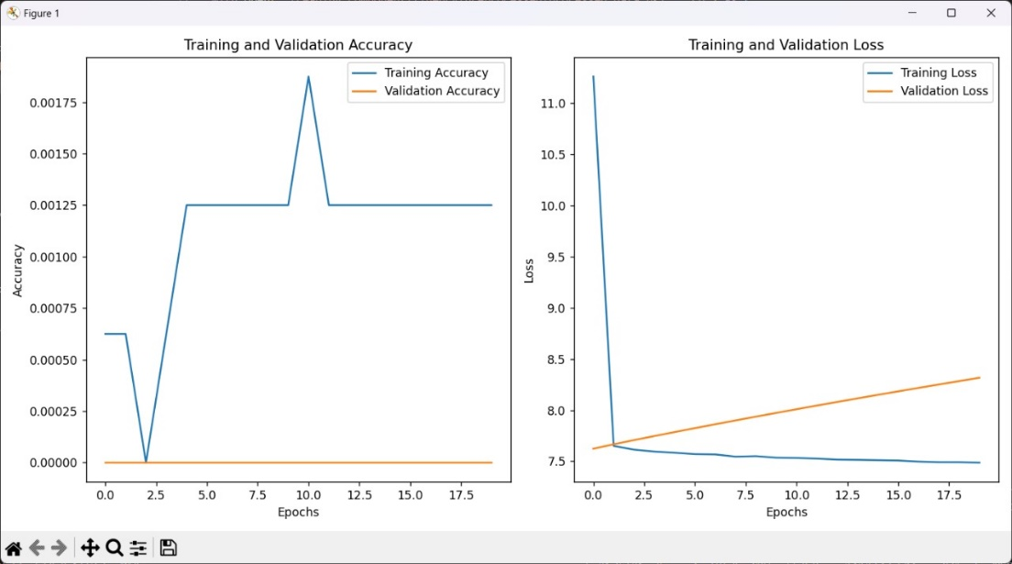
Model Training
Fluency model with LibraSpeech
IT21334542 | Sanjeeva.N | 24-25J-133

Slide 59
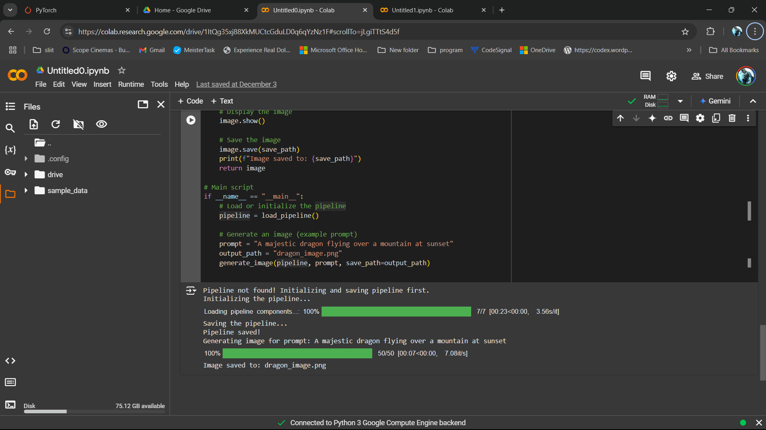
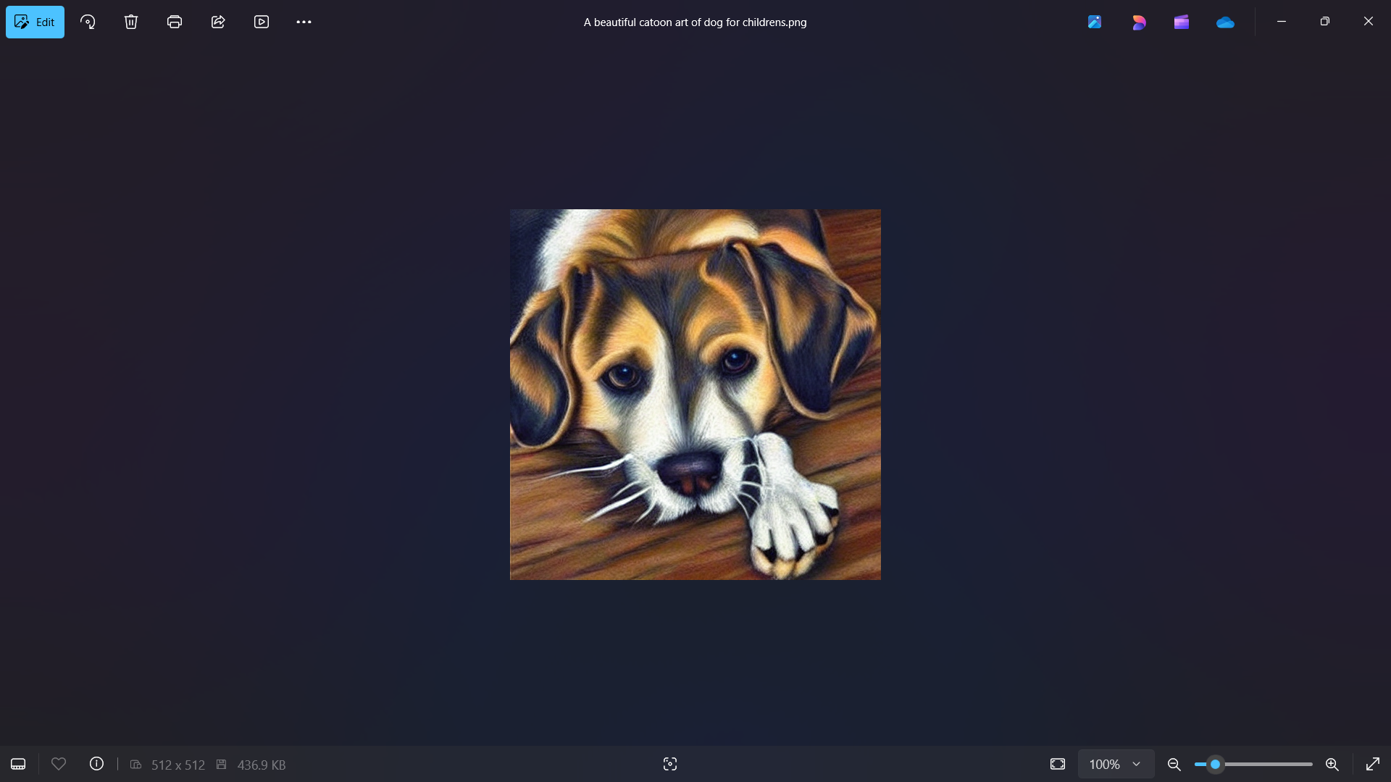
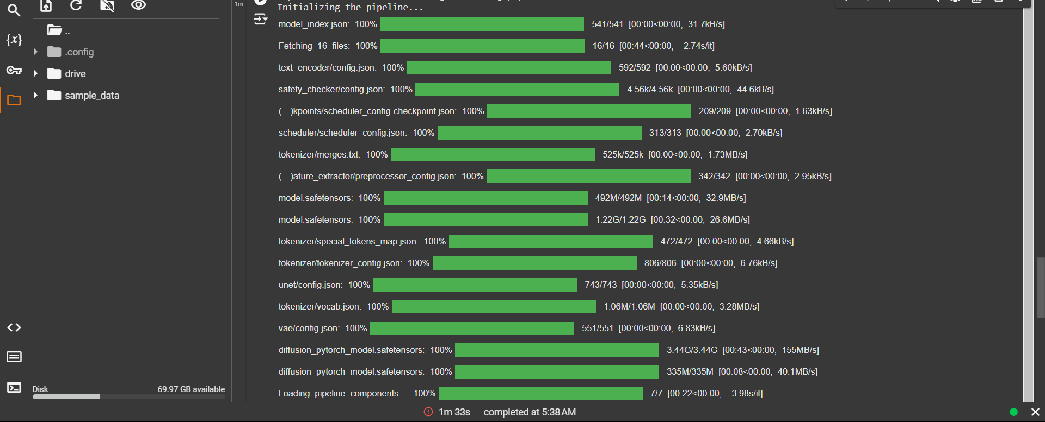
Model Training
Huggingface
IT21334542 | Sanjeeva.N | 24-25J-133

Slide 60
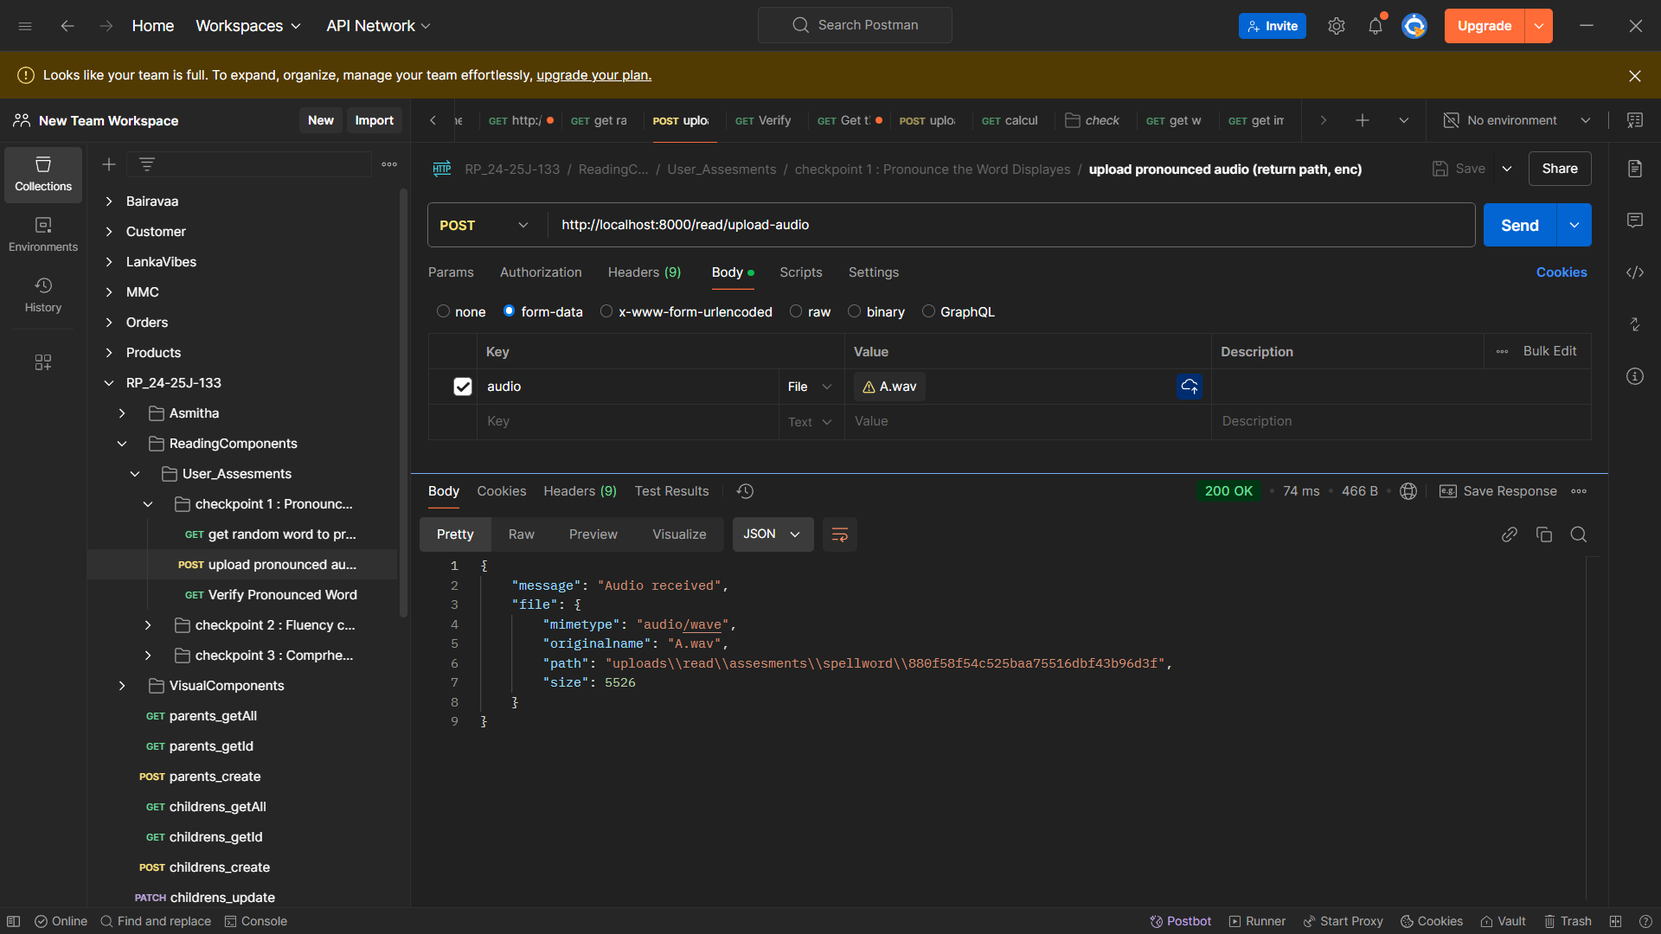
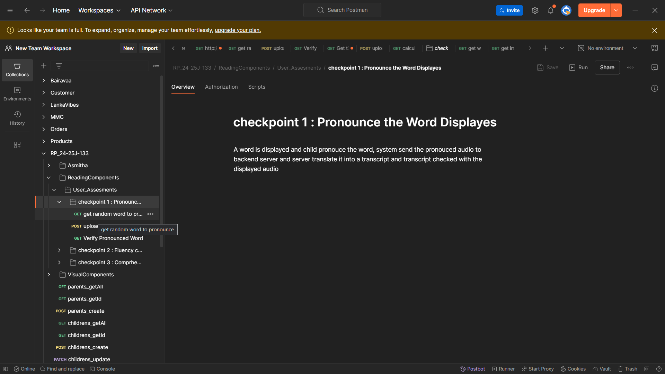
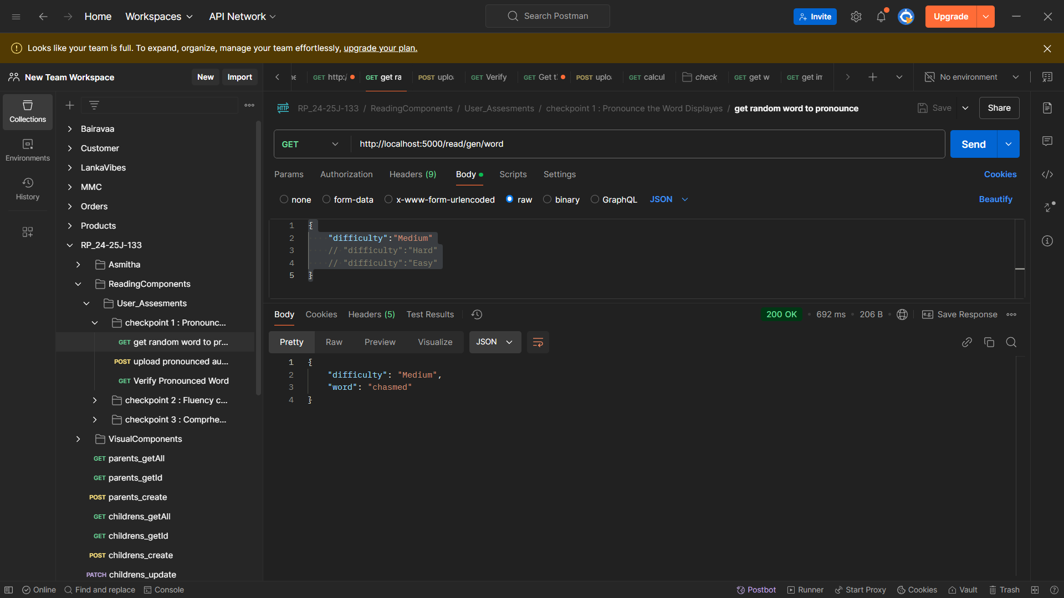

Working Component - Pronounce
Check Point 1 : Pronounce a word
Check Point 1 : Pronounce a word
IT21334542 | Sanjeeva.N | 24-25J-133

Slide 61
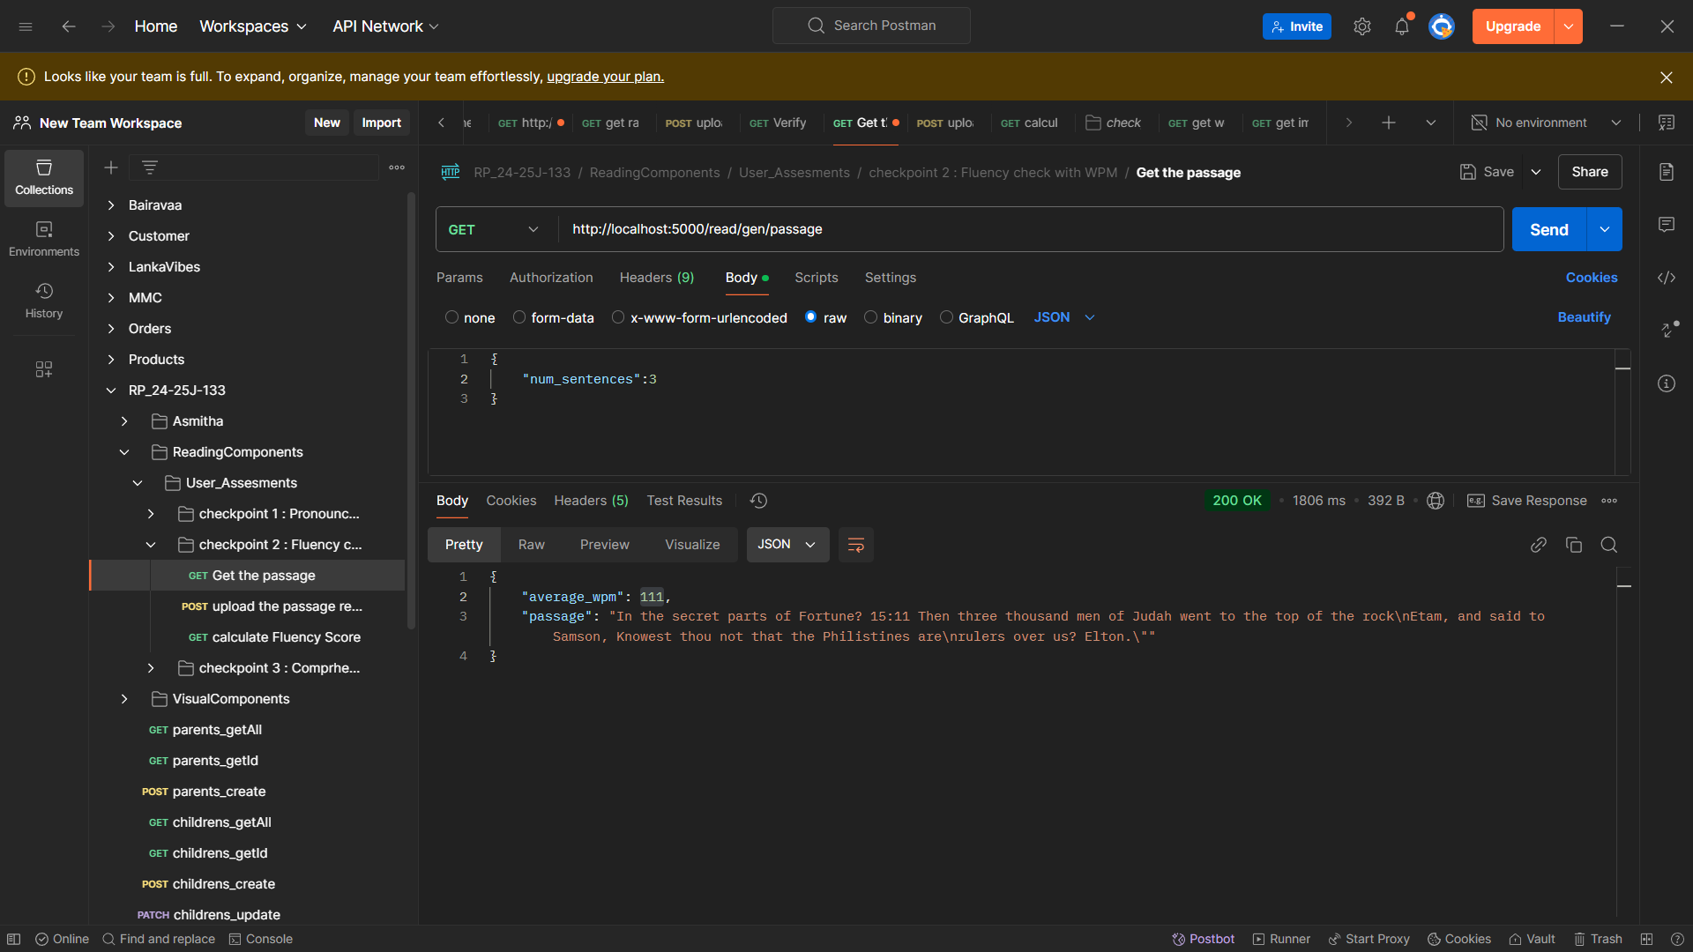
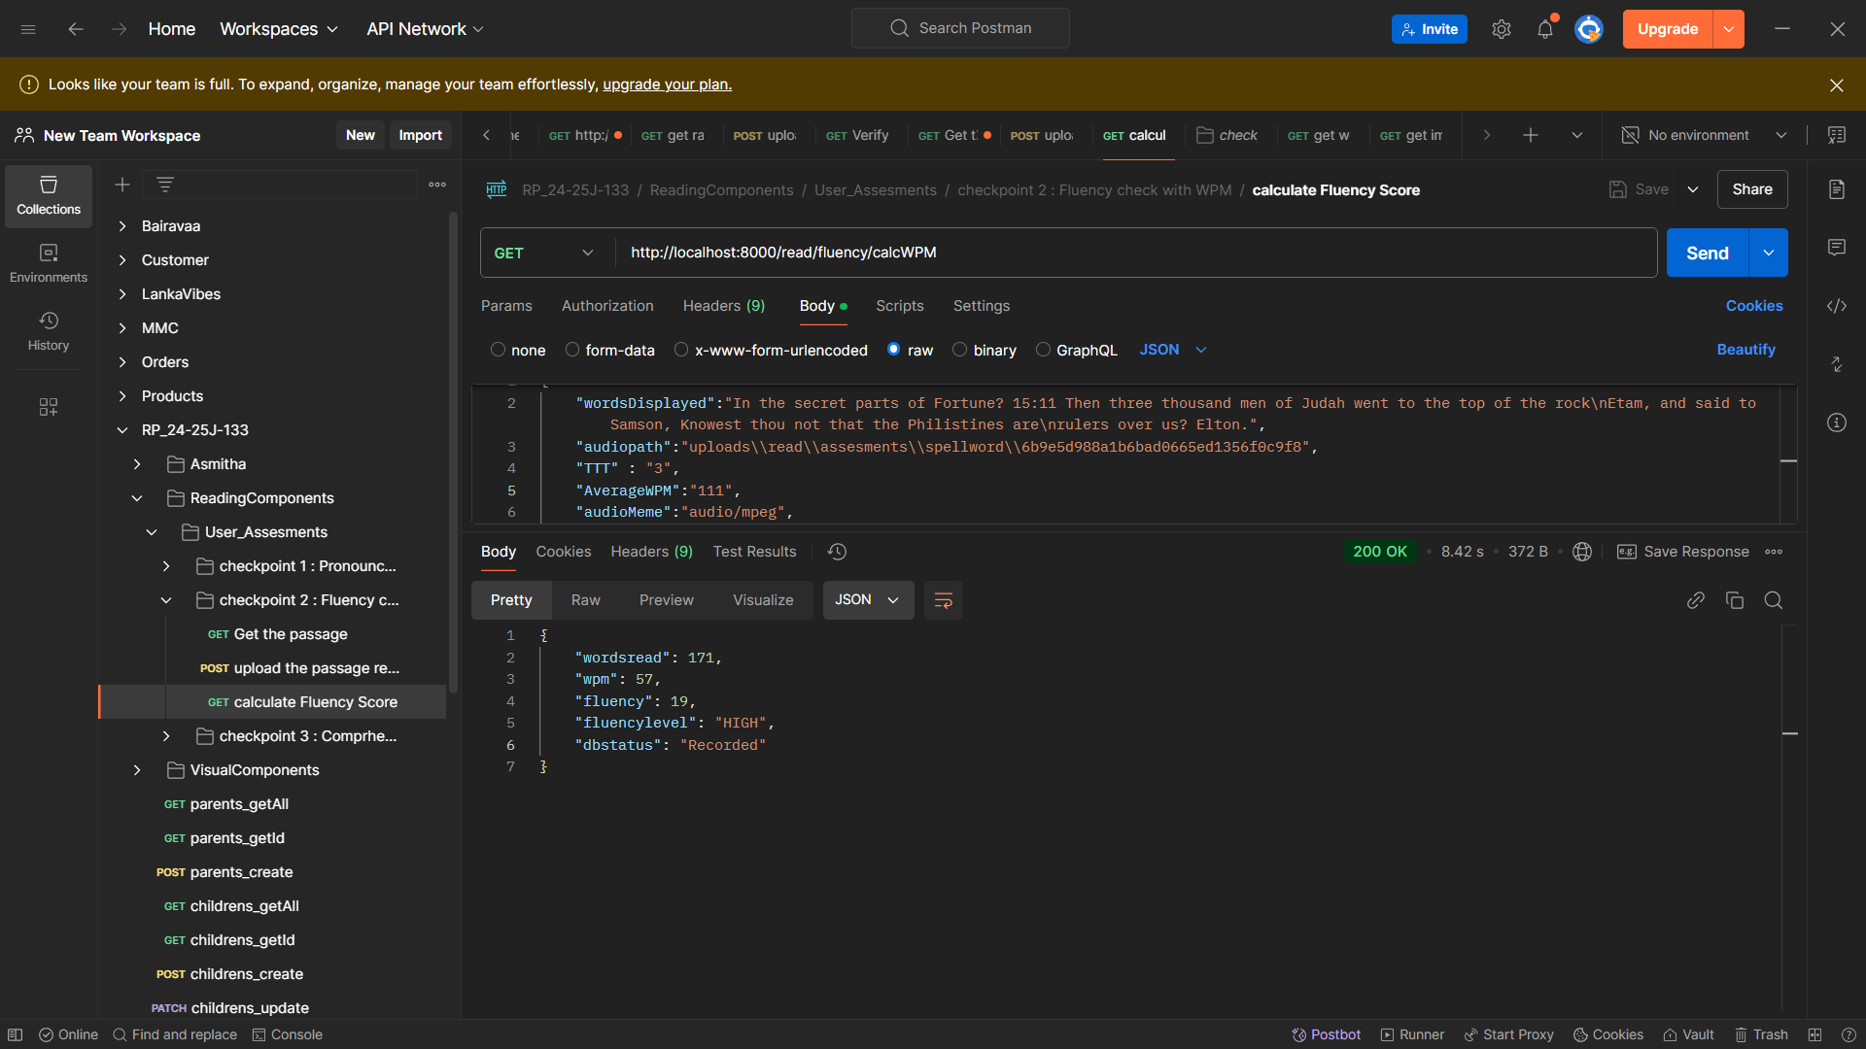
Working Component - Fluency
Check Point 1 : Fluency with Word per Minute
IT21334542 | Sanjeeva.N | 24-25J-133

Slide 62
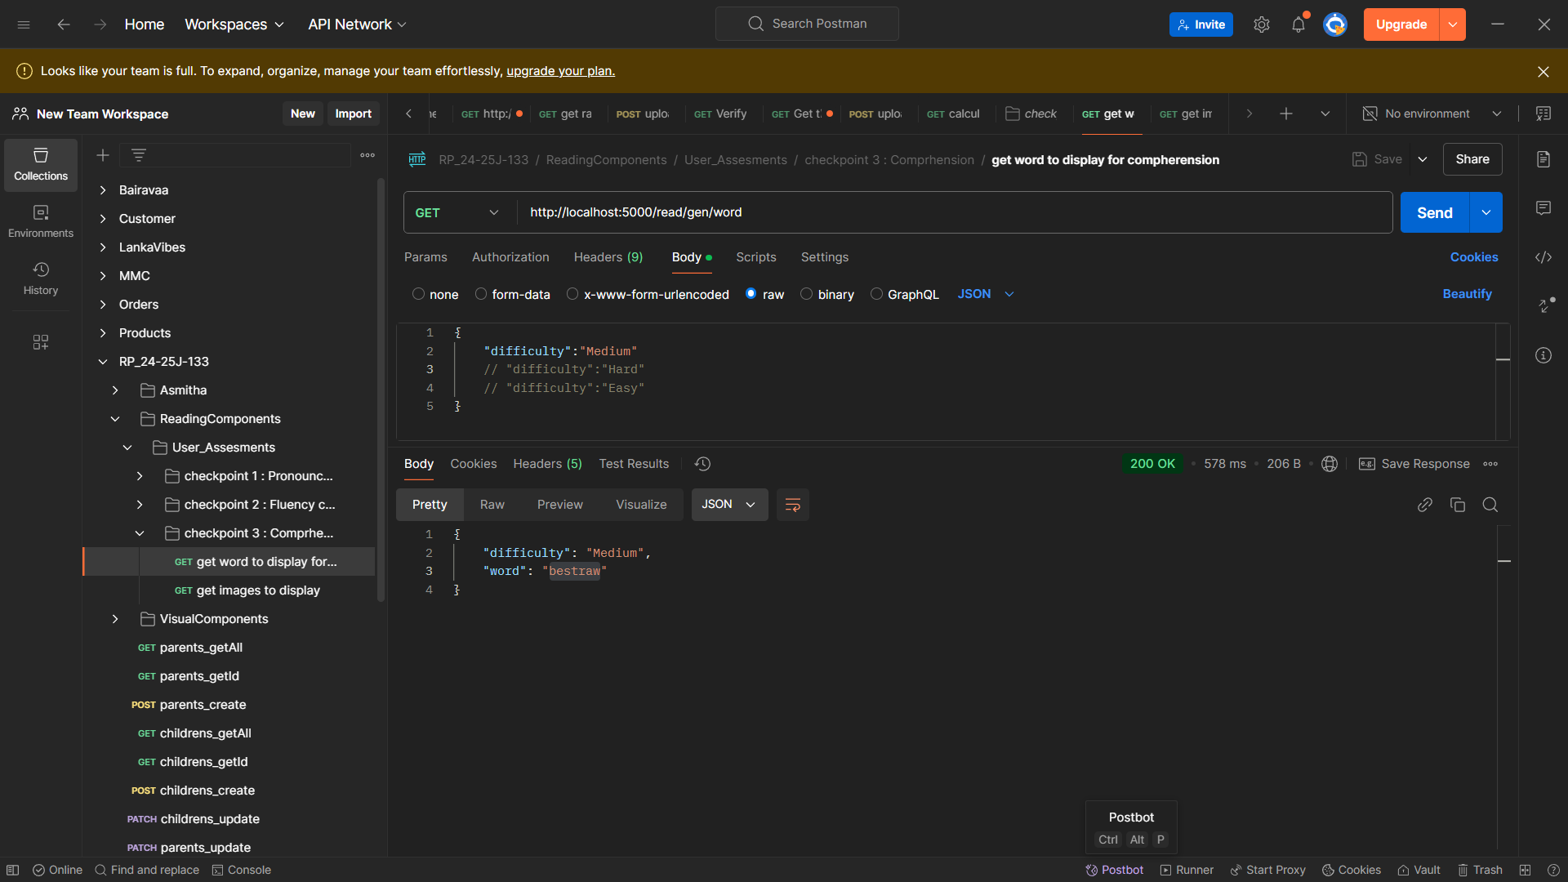
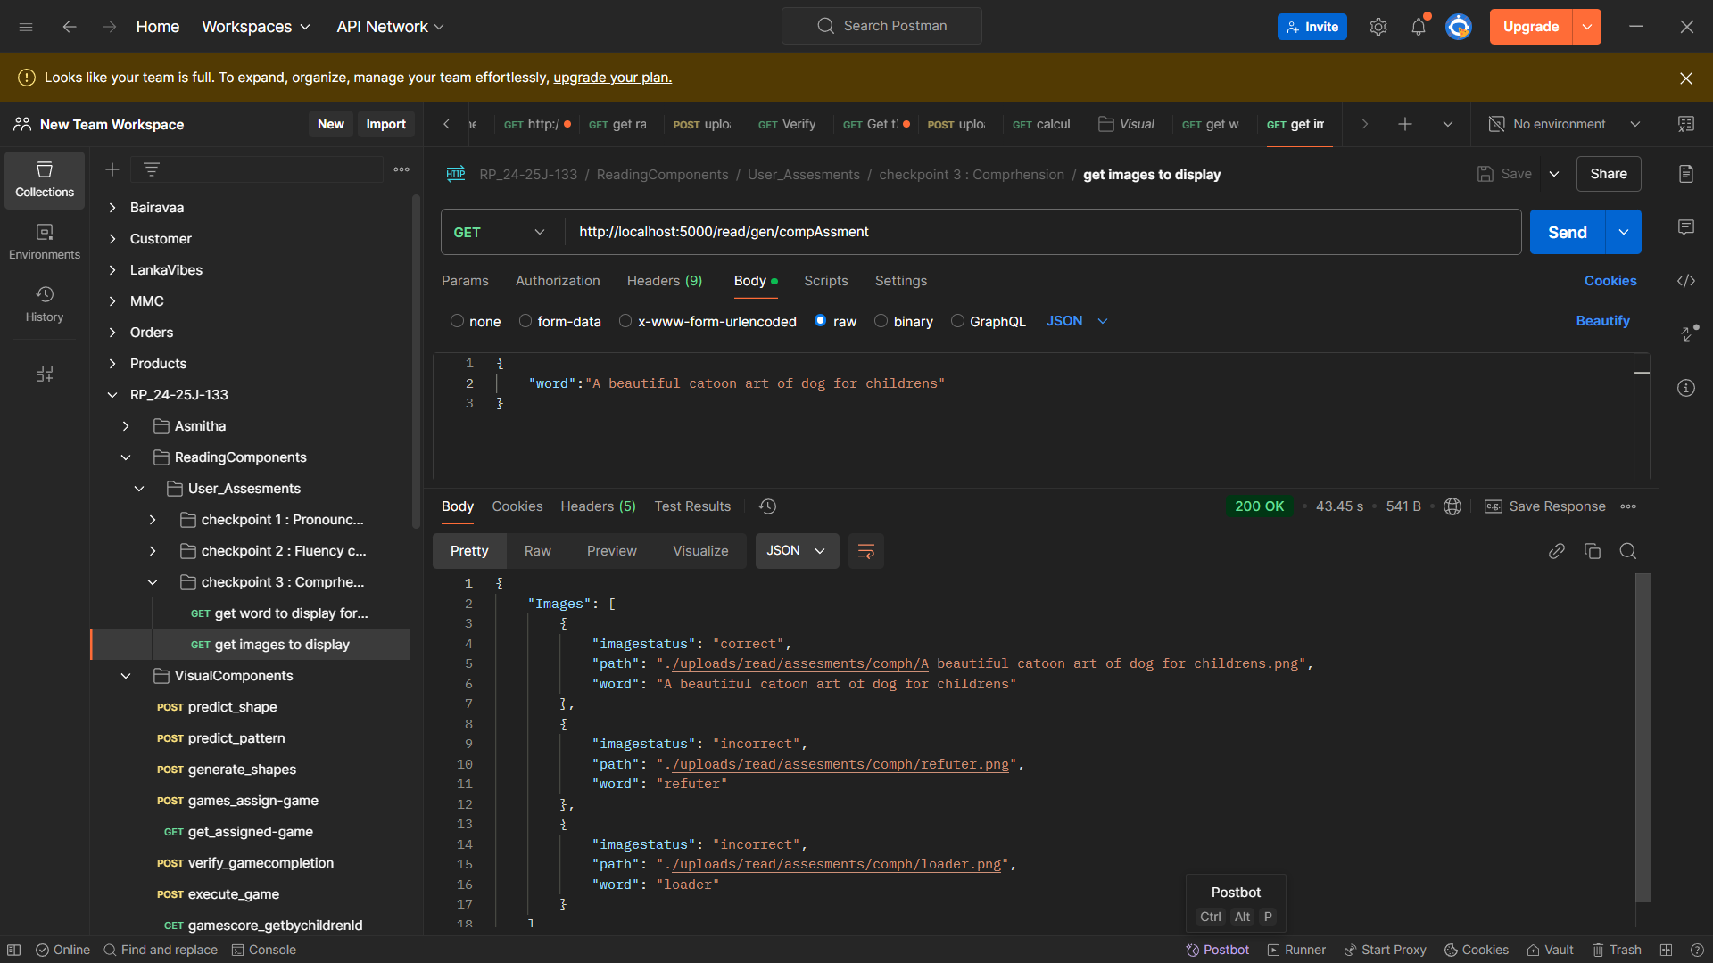
Working Component - comprehension
Check Point 2 : Understand the Word and Visualize the Meaning
IT21334542 | Sanjeeva.N | 24-25J-133

Slide 63
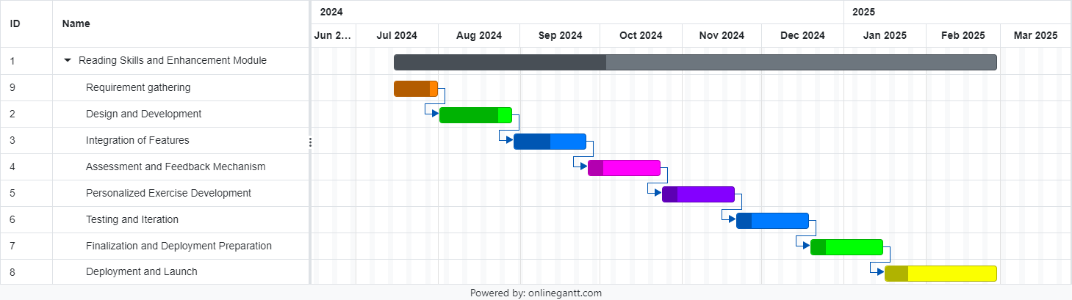
Work Breakdown Structure
Gannt Chart
IT21334542 | Sanjeeva.N | 24-25J-133

Slide 64
References
[1] machinelearningforkids, "machinelearningforkids," [Online]. Available: https://machinelearningforkids.co.uk/. [Accessed 12 06 2024].
[2] Ken Koedinger, Shivang (Shiv) Gupta, Danielle Thomas, Erin Gatz and Bill Guo, "Personalized Learning Squared (PLUS)," PLUS, 2022. [Online]. Available: https://hcii.cmu.edu/project/personalized-learning-squared-plus. [Accessed 15 06 2024].
[3] Ceren Korkmaz and Ana-Paula Correia, "A review of research on machine learning in educational technology," Research Gate, vol. 56, no. 6, pp. 1-18, 11 2019.
[4] Robert Y. Lee, Erin K. Kross, Janaki Torrence, Kevin S. Li, James Sibley, Trevor Cohen, William B. Lober, Ruth A. Engelberg and J. Randall Curtis, "Assessment of Natural Language Processing of Electronic Health Records to Measure Goals-of-Care Discussions as a Clinical Trial Outcome," JAMA Netw Open, vol. 6, no. 3, 02 03 2023.
[5] Thomas Nordström, Staffan Nilsson, Stefan Gustafson and Idor Svensson, "Assistive technology applications for students with reading difficulties: special education teachers' experiences and perceptions," Pub Med, vol. 14, no. 08, pp. 798-808, 11 2019.
IT21334542 | Sanjeeva.N | 24-25J-133

Slide 65
It21176210|Thiraviyarasa.A
SOFTWARE ENGINEERING
IT21 | Thiraviyarasa.A | 24-25J-133

Slide 66

Component 03
Short-term Memory Enhancement Module
IT21176210 | Thiraviyarasa.A | 24-25J-133

Slide 67
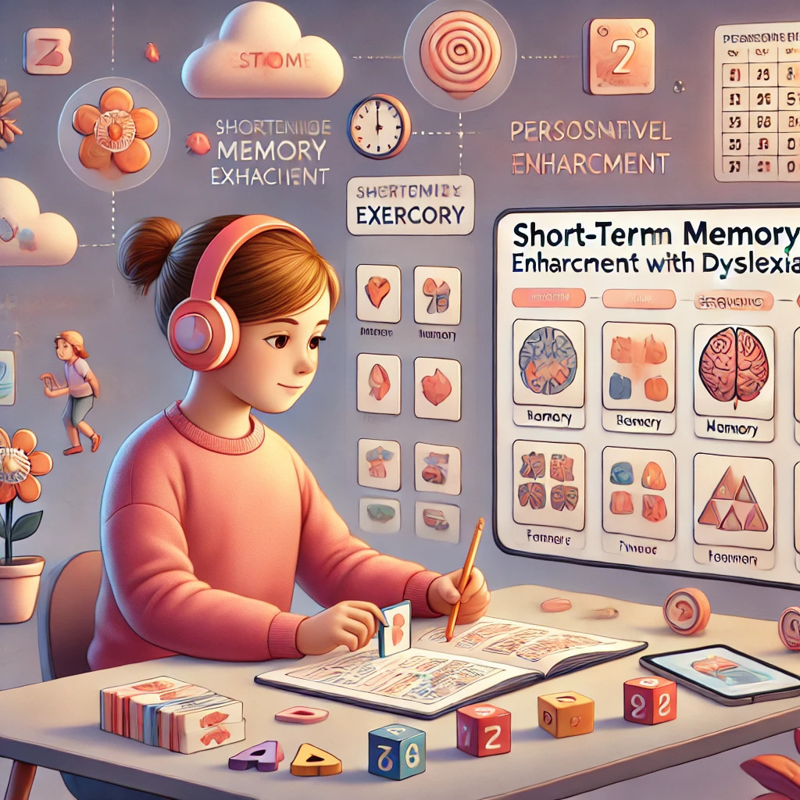
Introduction
Background
Research probelem
Objectives
IT21176210 | Thiraviyarasa.A | 24-25J-133

Slide 68

Background
Short-term memory plays a crucial role in learning and academic achievement, yet many individuals struggle with retaining information in their working memory.
Research has shown that short-term memory deficits can significantly impact academic performance, particularly in subjects like mathematics and reading.
Current interventions often focus on compensatory strategies, but there is a need for a more comprehensive approach that targets the underlying cognitive processes.
The Short-term Memory Enhancement Module is designed to address this need by providing personalized training and exercises to improve short-term memory capacity.
IT21176210 | Thiraviyarasa.A | 24-25J-133

Slide 69
Research problem
How can machine learning techniques be employed to develop adaptive memory training exercises that effectively enhance the short-term memory of children with dyslexia?
IT21176210 | Thiraviyarasa.A | 24-25J-133

Slide 70
Specific and Sub Objectives
Main Objective:
To design and develop a Short-term Memory Enhancement Module that improves the short-term memory skills of children with dyslexia.
Sub-Objectives:
Enhance Short-term Memory
Improve Working Memory
Increase Memory Capacity
IT21176210 | Thiraviyarasa.A | 24-25J-133

Slide 71
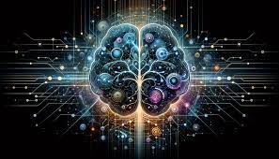
Methodology
System Diagram
Tool & Technologies
Github Commits
IT21176210 | Thiraviyarasa.A | 24-25J-133

Slide 72
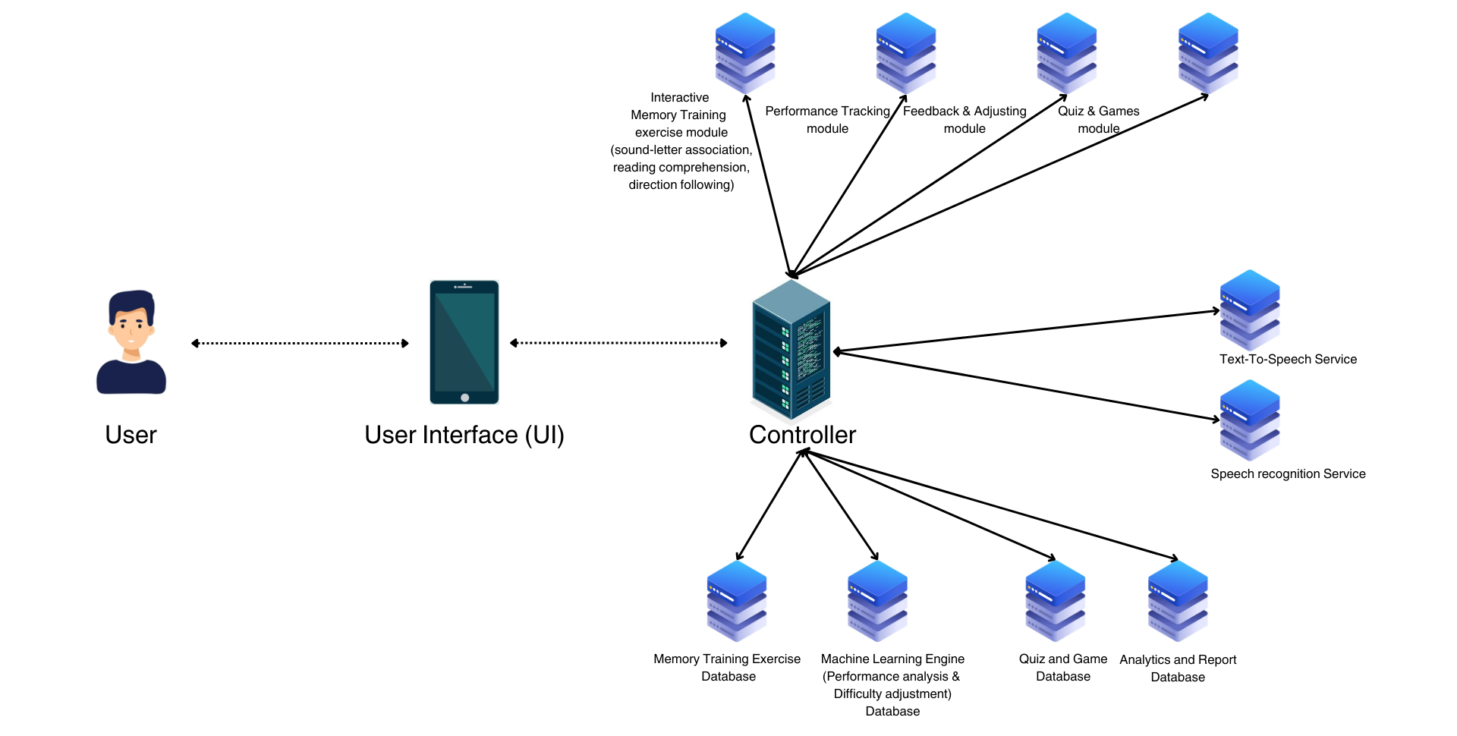
Methodology
System Diagram
IT21176210 | Thiraviyarasa.A | 24-25J-133

Slide 73

Tools & Technologies
Technologies
Machine learning
Languages
Python, Flutter
Storage
MongoDB (pymongo)
IT21176210 | Thiraviyarasa.A | 24-25J-133

Slide 74
Requirements
Functional
Memory Training Exercises
Performance Data Analysis
Personalized Memory Exercises
Non-Functional
Efficiency
Security
Adaptability
IT21176210 | Thiraviyarasa.A | 24-25J-133

Slide 75
Key Features
1. Model Training for Identify Shape, Predict word and Digit span task
IT21176210 | Thiraviyarasa.A | 24-25J-133

Slide 76



Key Features
2. Testing and Accuracy
Achieved accuracy:
Shape recognition model: ~95%
word prediction model: ~92%
Identify Digits model: ~92%
Performed k-fold cross-validation to ensure model robustness.
Digits Generation
Shape Generation
Predict word
IT21176210 | Thiraviyarasa.A | 24-25J-133

Slide 77
Challenges and Solutions
Overfitting
Challenge: Models were overfitting due to limited training data.
Solution:
Introduced data augmentation to increase dataset variability.
Added dropout and batch normalization to regularize the model.
Used early stopping to halt training once validation loss plateaued.
IT21176210 | Thiraviyarasa.A | 24-25J-133

Slide 78
Completion And Remaining Project
Completed
Pending
Train Model.
Evaluate the Model.
Integrate Python to generate Shapes , Words and Digits.
Real time Level updating of children.
User Management.
Input Validation for requests.
Frontend.
Deployment.
IT21176210 | Thiraviyarasa.A | 24-25J-133

Slide 79




Model Training
Identify Shape
IT21176210 | Thiraviyarasa.A | 24-25J-133

Slide 80




Model Training
Predict Word
IT21176210 | Thiraviyarasa.A | 24-25J-133

Slide 81




Model Training
Digit Span task
IT21176210 | Thiraviyarasa.A | 24-25J-133

Slide 82


Working Component
Identify Shape
IT21176210 | Thiraviyarasa.A | 24-25J-133

Slide 83


Working Component
Predict Word
Recognize Digits
IT21176210 | Thiraviyarasa.A | 24-25J-133

Slide 84

Work Breakdown Structure
Gannt Chart
IT21176210 | Thiraviyarasa.A | 24-25J-133

Slide 85

Git Commits
IT21176210 | Thiraviyarasa.A | 24-25J-133

Slide 86
References
[1] Thomas S. Redick, Zach Shipstead, Elizabeth A. Wiemers, Monica Melby-Lervåg and Charles Hulme , "What’s Working in Working Memory Training? An Educational Perspective," Springer Link, vol. 27, p. 617–633, 02 06 2015.
[2] Blanka Klimova and Martin Valis, "Smartphone Applications Can Serve as Effective Cognitive Training Tools in Healthy Aging," PMC, pp. 9-436, 04 01 2018.
[3] Reut Shani, Shachaf Tal, Sigal Zilcha-Mano and Hadas Okon-Singer, "Can Machine Learning Approaches Lead Toward Personalized Cognitive Training?," PMC, pp. 13-64, 04 04 2019.
[4] Kanyin Feng, Xiao Zhao, Jing Liu, Ying Cai, Zhifang Ye, Chuansheng Chen and Gui Xue, "Spaced Learning Enhances Episodic Memory by Increasing Neural Pattern Similarity Across Repetitions," PMC, vol. 39, no. 27, p. 5351–5360, 03 07 2019.
[5] Gabriela Feitosa Esplendori, Rika Miyahara Kobayashi and Vilanice Alves de Araújo Püschel , "Multisensory integration approach, cognitive domains, meaningful learning: reflections for undergraduate nursing education," PMC, vol. 56, 11 04 2022.
IT21176210 | Thiraviyarasa.A | 24-25J-133

Slide 87

Q&A

Slide 88

THANK YOU

